Slide 1
Machine Learning
Source: https://scis.uohyd.ac.in/~atulcs/ml/Chap1.Part1.pdf

Slide 2
Machine Learning
Machine Learning
How to construct computer programs that automatically improve with experience
Examples:
  from medical records: treatments most effective
  houses learn to optimize energy costs
  search engines, computer games, adaptive user interfaces, personalized assistants, web bots, and scientific applications

Slide 3
Machine Learning
Machine Learning
Opens new uses of computers
  new levels of competence and customization
  better understanding of human learning abilities/disabilities

Slide 4
The Course
Machine Learning
Key algorithms and theory that form the core of machine learning
Draws heavily from concepts and results from:
  Statistics
  Artificial Intelligence
  Philosophy
  Information theory
  Biology
  Computational complexity
  Control theory

Slide 5
Achievements in Machine Learning
Machine Learning
Recognizing spoken words
Recognizing handwritten words
Predict recovery rates for pneumonia patients
Detect fraudulent use of credit cards
Drive autonomous vehicles on highways
Play backgammon approaching human world champion

Slide 6
Some Successful Applications of Machine Learning
Machine Learning
Learning to recognize spoken words
  Speaker-specific strategies for recognizing primitive sounds (phonemes) and words from speech signal
  Neural networks and methods for learning HMMs for customizing to individual speakers, vocabularies and microphone characteristics

Slide 7
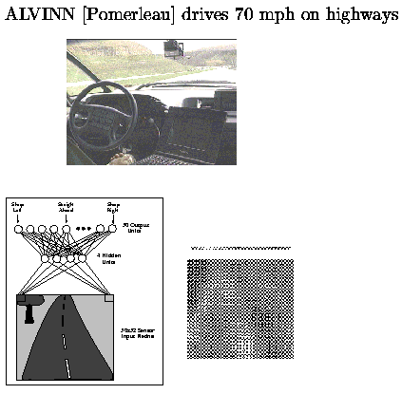
Some Successful Applications of Machine Learning
Machine Learning
Learning to drive an autonomous vehicle
  Train computer-controlled vehicles to steer correctly
  Drive at 70 mph for 90 miles on public highways
  Associate steering commands with image sequences

Slide 8
Problems Too Difficult To Program by Hand
Machine Learning

Slide 9
Scientific Application of Machine Learning
Machine Learning
Learning to classify new astronomical structures
  Very large databases to learn general regularities implicit in the data
  Classify celestial objects from image data
  Decision tree algorithms are now used by NASA to classify all objects in sky survey which consists of 3 terabytes of image data

Slide 10
Well-Posed Learning Problems
Machine Learning
Definition:
A computer program is said to learn from experience E
with respect to some class of tasks T and
performance measure P,
if its performance at tasks T, as measured by P, improves with experience E.

Slide 11
Well-defined Learning Problem
Machine Learning
Identify three features
  class of tasks
  measure of performance to be improved
  source of experience

Slide 12
A Robot Driving Learning Problem
Machine Learning
Task T: driving on public, 4-lane highway using vision sensors
Performance measure P: average distance traveled before an error (as judged by human overseer)
Training experience E: a sequence of images and steering commands recorded while observing a human driver

Slide 13
A Handwriting Recognition Learning Problem
Machine Learning
Task T: recognizing and classifying handwritten words within images
Performance measure P: percent of words correctly classified
Training experience E: a database of handwritten words with given classifications

Slide 14
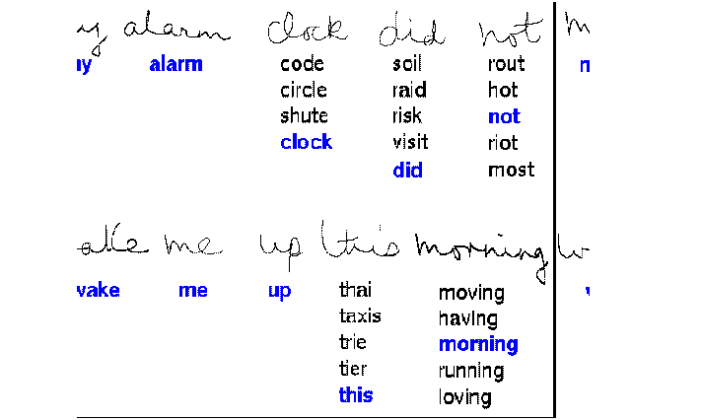
Handwriting Recognition Learning
Machine Learning

Slide 15
Text Categorization Problem
Machine Learning
Task T: assign a document to its content category
Performance measure P: Precision and Recall
Training experience E: Example pre- classified documents

Slide 16
Broad Definition of Learning
Machine Learning
Include most tasks conventionally called “learning”
Encompass computer programs that improve from experience is straightforward ways:
  DBMS that allows users to update entries which improves answering database queries
Goal is to:
  Define precisely a class of problems that forms interesting forms of learning, explore algorithms to solve such problems, understand fundamental structure of learning problems and processes

Slide 17
Disciplines: Influence on Machine Learning
Machine Learning
Artificial intelligence
  learning symbolic representations of concepts
  machine learning as a search problem
  learning as an approach to improving problem solving
Pattern recognition
  Bayes’ theorem for calculating hypothesis probabilities
  Naïve Bayes classifier

Slide 18
Disciplines: Influence on Machine Learning
Machine Learning
Computational complexity theory
  Theoretical bounds on complexity of different learning tasks measured in terms of no of training samples, no of mistakes

Slide 19
Disciplines: Influence on Machine Learning
Machine Learning
Control theory
  procedures to control processes to optimize predefined objectives and predict next state of process controlled
Information theory
  measures of entropy, information content
  minimum description length approaches to learning
  optimal codes and relationship to optimal training sequences for encoding hypothesis

Slide 20
Disciplines: Influence on Machine Learning
Machine Learning
Philosophy
  Occam’s razor--simplest hypothesis is best (decision trees)
  justifying generalizing beyond observed data

Slide 21
Disciplines: Influence on Machine Learning
Machine Learning
Psychology and neurobiology
  power law of practice-- human response improves with performance
Statistics
  characterization of errors (eg, bias and variance) that occur when estimating the accuracy of a hypothesis based on a limited sample of data
  confidence intervals, statistical tests

Slide 22
Perspectives & Issues
Machine Learning
Machine Learning involves searching a very large space of possible hypotheses that fits observed data and any prior knowledge held by the observer

Slide 23
Issues in Machine Learning
Machine Learning
What algorithms are available for learning a concept? How well do they perform?
How much training data is sufficient to learn a concept with high confidence?
When and how can prior knowledge held by the learner guide the process of generalizing from examples?
Are some training examples more useful than others?

Slide 24
Issues in Machine Learning
Machine Learning
What is the best strategy for choosing a useful next training experience?
What is the best way to reduce the learning task to one or more function approximation systems?
How can the learner automatically alter its representation to represent and learn the target function?

Slide 25
Summary
Machine Learning
Machine learning algorithms have great practical value in a variety of application domains
Machine learning draws on ideas from a diverse set of disciplines
A well-defined learning problem requires a well- specified task, performance metric, and source of experience
Designing a machine learning approach involves a number of design choices
Learning involves search

