Slide 1
Blockchain Technology

Slide 2
Table of Contents
Introduction
  Blockchain terminologies
  Distinction between databases and blockchain ledgers
Cryptographic component
  Cryptography, hash functions and digital signatures
Consensus components
  Principles and paradigms of distributed systems
  Blockchain consensus algorithms
Blockchain structures
  Blockchain structure
  Types of blockchain

Slide 3
Introduction
  “To understand the power of blockchain systems, and the things they can do, it is important to distinguish between three things that are commonly muddled up, namely the bitcoin currency, the specific blockchain that underpins it and the idea of blockchains in general.”
  The Trust Machine, THE ECONOMIST, Oct. 31, 2015
Source: https://www.economist.com/leaders/2015/10/31/the-trust-machine
Notes:
That’s why it is very imporant to understand firstly the blockchain terminologies.

Slide 4
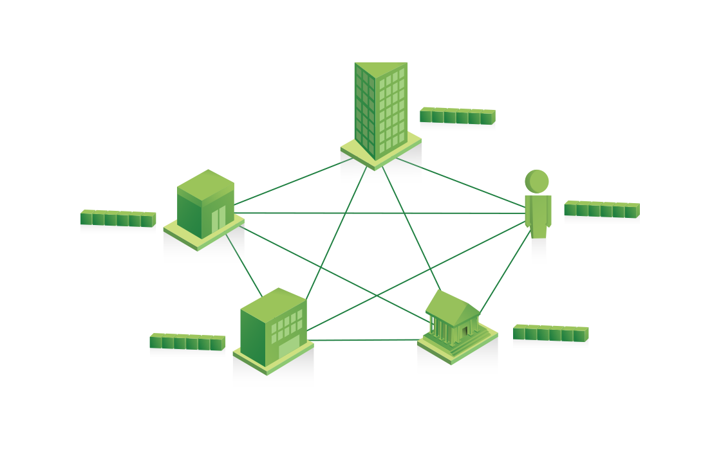
Blockchain terminologies
Blockchain – What is it?
  Aka DLT (Distributed Ledger Technology) - rudimentary shared accounting system
  Technologically, it is :
Distributed database – public ledger (you can insert, select data, but can’t update or delete data.
Distributed computer – execute digital contracts
Based on p2p (peer-to-peer) technology, cryptology and API
Image source: https://www.ibm.com/blockchain/assets/images/landing/blockchain_shared_ledger.png
Notes:
A general definition of Blockchain

Slide 5
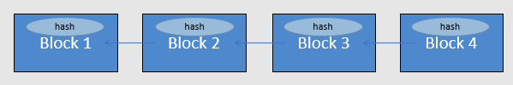
Blockchain terminologies
Blockchain – What is it?
In fact, the blockchain is more than a technology, it
  Usually contains financial transactions
  Is replicated across a number of systems in almost real-time
  Uses cryptography and digital signatures to prove identity, authenticity and enforce read/write access rights
  Can be written by everyone in a public blockchain (but only certain participants in a private blockchain)
  Can be read by participants, often a wider audience
  Has mechanisms to make it hard to change historical records, or at least make it easy to detect when someone is trying to do so
Source: https://miethereum.com/wp-content/uploads/2017/11/A.-A-Gentle-Introduction-To-Blockchain-Technology.pdf
Notes:
This slide explains in detail what Blockchain is in actual fact.

Slide 6
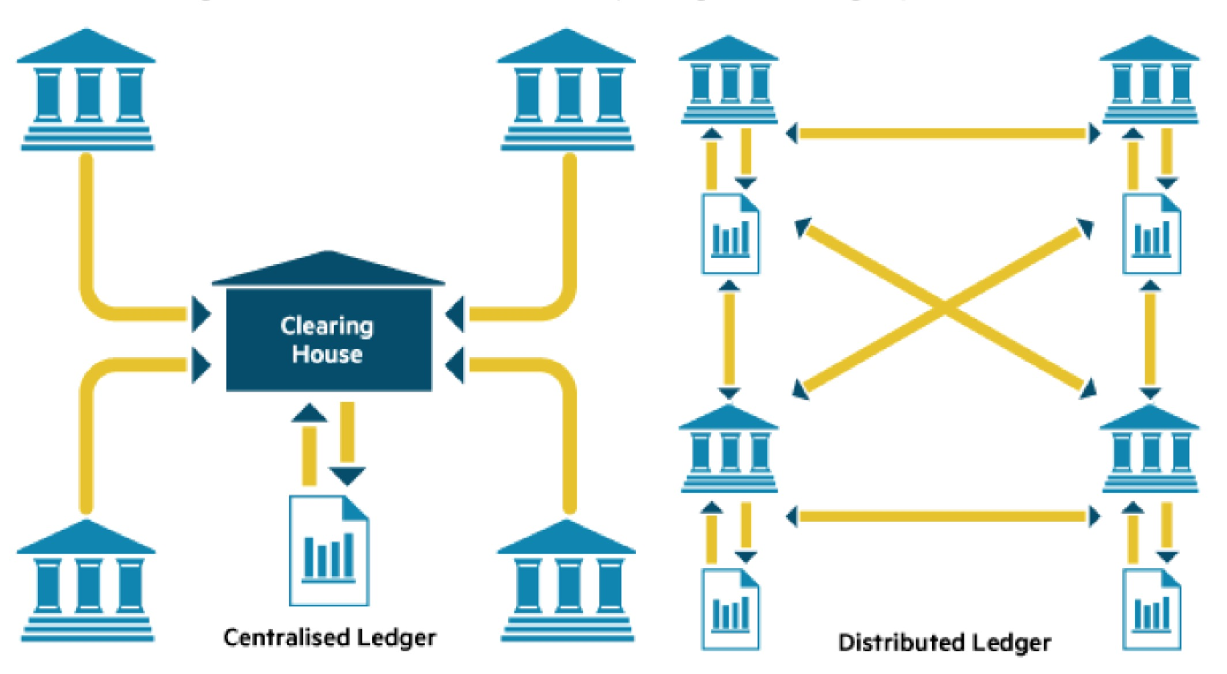
Blockchain terminologies
Distributed ledger – What is it?
Source: https://tradeix.com/distributed-ledger-technology/
Image source: https://knowledgecrypto.com/the-difference-between-blockchains-distributed-ledger-technology/
Notes:
Centralised Ledger:
Most companies currently use a centralised database that lives in a fixed location.
A centralised database essentially has a single point of failure.
Distributed Ledger:
A database that exists across several locations or among multiple participants, decentralized to eliminate the need for a central authority or intermediary to process, validate or authenticate transactions.
The records are only ever stored in the ledger when the consensus has been reached by the parties involved.

Slide 7
Blockchain terminologies
Distributed ledger – How it works?
Users initiate transactions using their Digital Signatures
Users Broadcast their transactions to Nodes
One or more Nodes begin validating each transaction
Nodes aggregate validated transactions into Blocks
Consensus protocol used
Block reflecting “true state” is chained to prior Block
Nodes Broadcast Blocks to each other
Source: https://ccl.yale.edu/sites/default/files/files/A%20Brief%20Introduction%20to%20Blockchain%20(Final%20without%20Notes).pdf
Notes:
Explain how the distributed ledger works (from users to nodes until the block is validated and added into the chain).
Source: “A brief introduction to blockchain”, Nancy LIAO, 2005

Slide 8
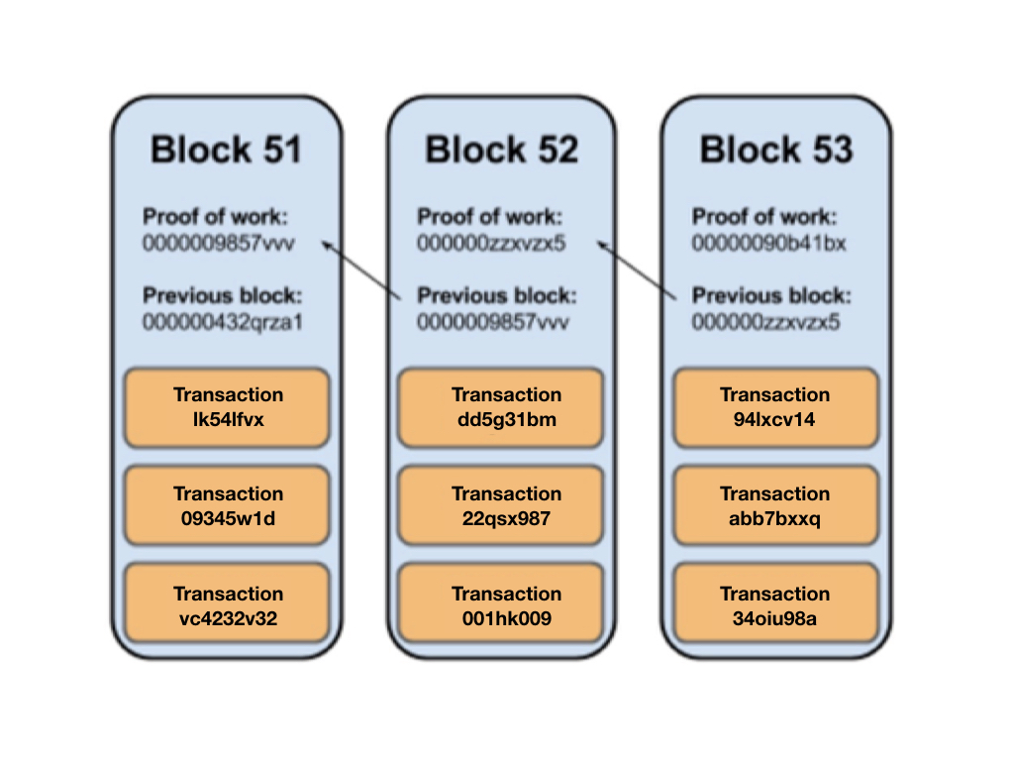
Blockchain terminologies
Transaction & blocks
  A transaction is a value transfer; a block is a collection of transactions on the bitcoin network, gathered into a block that are hashed and added to the blockchain.
Image source: https://pplware.sapo.pt/informacao/monero-xmr-uma-moeda-segura-privada-e-sem-rasto/

Slide 9
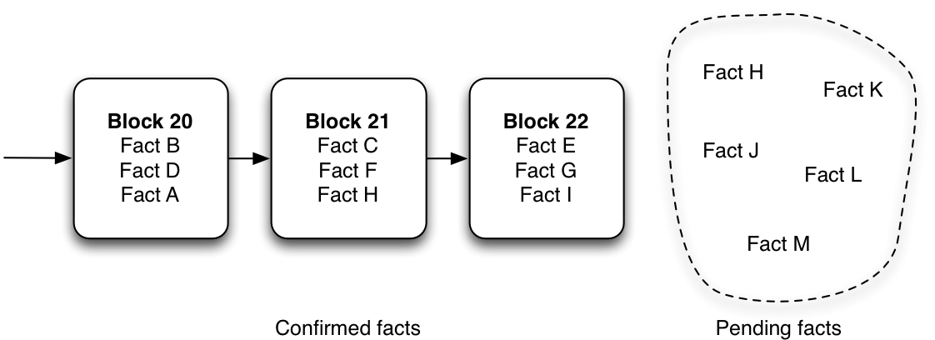
Blockchain terminologies
Mining
  This process of solving cryptographic problems using computing hardware also triggers the release of cryptocurrencies
Source:
https://marmelab.com/blog/2016/05/12/blockchain-expliquee-aux-developpeurs-web-la-theorie.html
Notes:
For example, if the Fact F is in the Block 21 and the Fact E in the Block 22, then the whole network considers that the fact E is later than the fact F. Before being grouped in a block, the facts are pending.

Slide 10
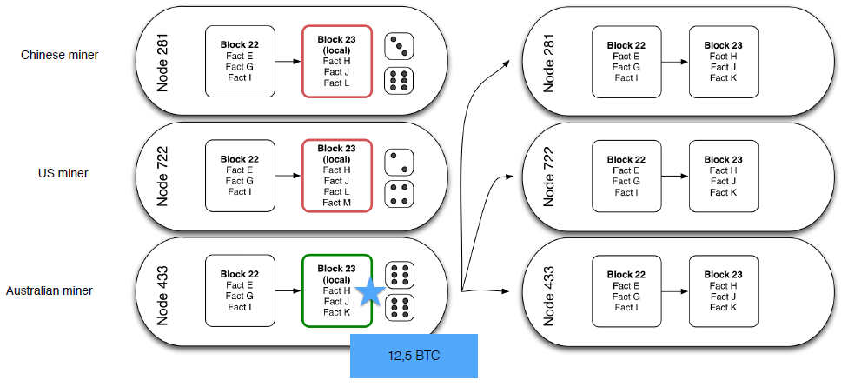
Blockchain terminologies
Mining
  The process by which transactions are verified and added to a blockchain.
Source:
https://marmelab.com/blog/2016/05/12/blockchain-expliquee-aux-developpeurs-web-la-theorie.html
Notes:
This process of solving cryptographic problems using computing hardware also triggers the release of cryptocurrencies.
By default, a node is not a miner, it is any computer that connects to the blockchain network - it just receives blocks that have been mined by other nodes. It is a voluntary process to transform a node into a miner.

Slide 11
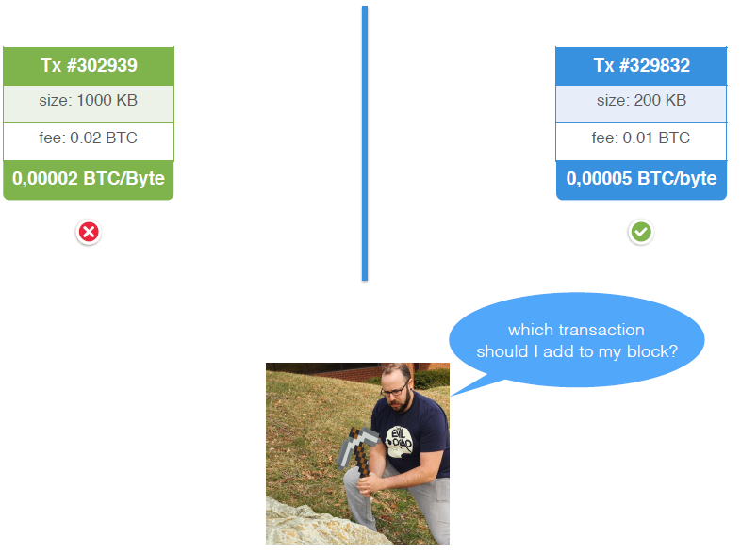
Blockchain terminologies
Mining
  Miners on the network select transactions from pools and form them into a ‘block’.
Image source: https://www.thinkgeek.com/images/products/additional/carousel/e847_minecraft_pickaxe_inuse.jpg
Notes:
Every miner constructs their own block, but multiple miners can select the same transaction to be included in their block.

Slide 12
Blockchain terminologies
Forks
  A fork is the creation of an ongoing alternative version of the blockchain, by creating two blocks simultaneously on different parts of the network. This creates two parallel blockchains, where one of the two is the winning blockchain.
  When does it happens?
  • Block found at the same time
  • Software incompatibility
  • “We don’t agree” split
Source: https://medium.com/my-blockchain-bible/101-blockchain-terminology-874f007c0270

Slide 13
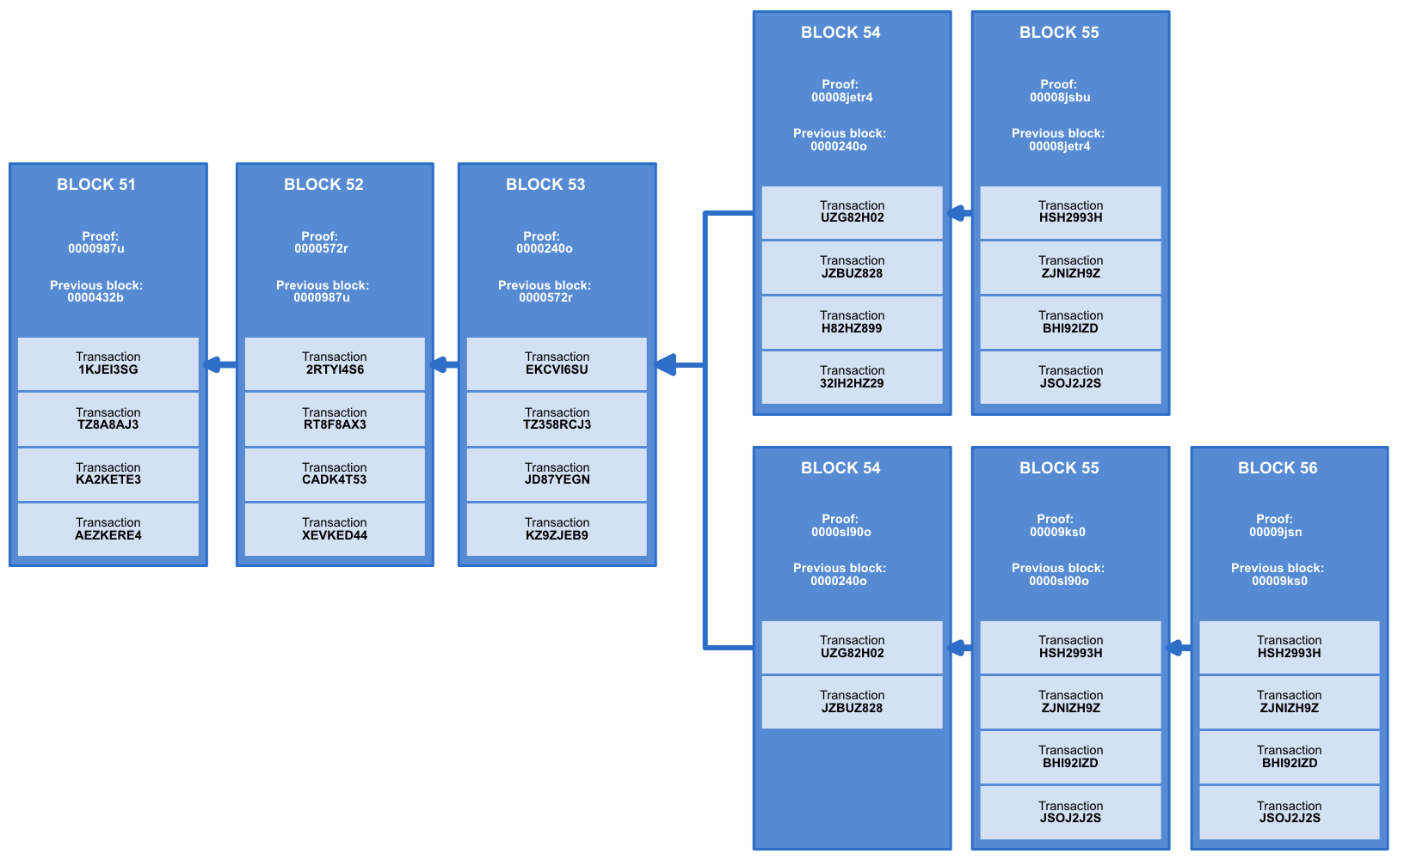
Blockchain terminologies
Forks
Image source: Scorechain
Notes:
This is an example of a fork.

Slide 14

Blockchain terminologies
Bitcoin
  Crypto currency, first asset based on Blockchain
  Used for drug/weapons e-commerce, ransom ware
  Used for remittance, speculation, store of value
  “What is needed is an electronic payment system based on cryptographic proof instead of trust, allowing any two willing parties to transact directly with each other without the need for a trusted third party.”
  Satoshi Nakamoto – October 31st, 2008
Source: https://medium.com/@flatoutcrypto/what-is-the-point-of-eos-ad385740b05f

Slide 15
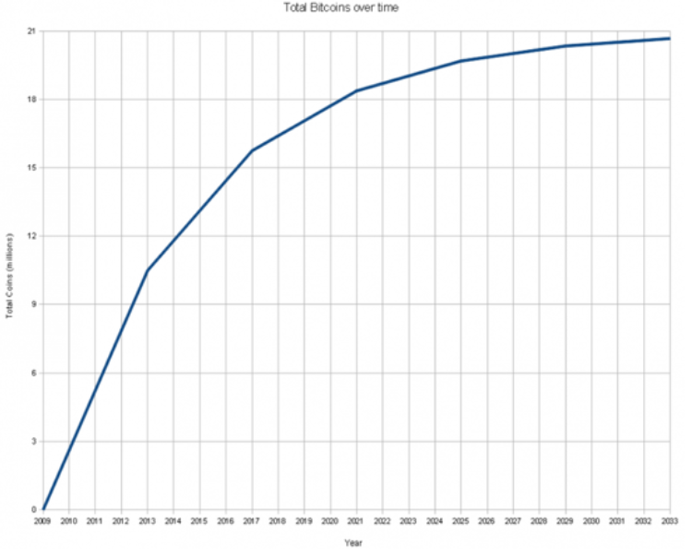
Blockchain terminologies
Bitcoin
  Monetary creation
Image source: https://upload.wikimedia.org/wikipedia/commons/thumb/5/54/Total_bitcoins_over_time.png/740px-Total_bitcoins_over_time.png
Notes:
Nakamoto himself mined the first 50 bitcoins, the genesis block, on January 3rd, 2009.
The time the last Bitcoin will be created varies and is subject to speculation based on assumptions.
Due to the mining power having increased overall over time, assuming mining power remained constant from that block forward - the last Bitcoin will be mined on May 7th, 2140.
Source: https://en.bitcoin.it/wiki/Controlled_supply

Slide 16
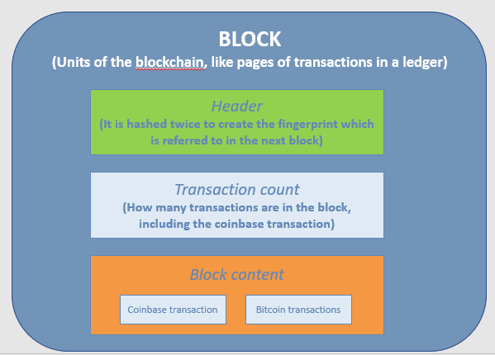
Blockchain terminologies
Bitcoin
  Inside Bitcoin’s Blockchain
Source: https://bitsonblocks.files.wordpress.com/2015/09/bitcoin_blockchain_infographic1.jpg

Slide 17
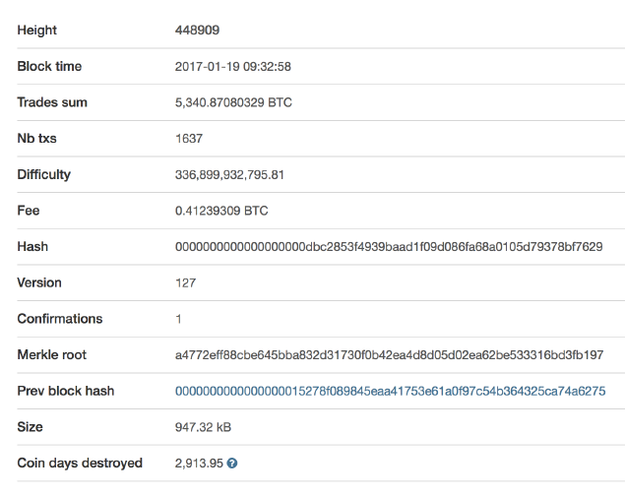
Blockchain terminologies
Bitcoin
  Inside Bitcoin’s Blockchain
  - Block Header : includes Technical
  data, Previous block hash, Merkle Root,
  Timestamp, Difficulty target, Nonce.
  Here is an example:
Source: https://bitsonblocks.files.wordpress.com/2015/09/bitcoin_blockchain_infographic1.jpg
Image source: www.blockchain.com

Slide 18
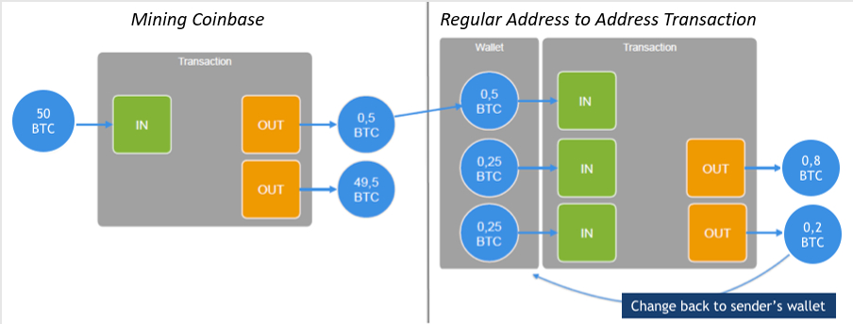
Blockchain terminologies
Bitcoin
  Inside Bitcoin’s Blockchain
  - Block content : Transaction Flow
Image source: Scorechain
Notes:
Mining Coinbase/Mining reward (the chart on the left):
The bit where you get to pay yourself the mining reward plus the fees from the transactions included in the block.
Regular Address to Address Transaction (the chart on the right):
The main payload of the block. Contains bitcoin payments.
UTXO (Unspent Transaction Output): UTXOs are processed continously in bitcoin network and they can be spent as an input in a new transaction. For example in this chart on the right, 0.2 BTC is UTXO in this Transaction.

Slide 19
Blockchain terminologies
Bitcoin
  Inside Bitcoin’s Blockchain
  - Block Transaction example:
Image source: www.blockchain.com
Notes:
Block Transactions includes Technical data (Version number, Transaction lock time, Input count, Output count), Inputs (Which coins are being spent), Outputs (Who is getting the coins).

Slide 20
Blockchain terminologies
Bitcoin
  How the
  money transfer works
Image source: https://www.weusecoins.com/images/bitcoin-transaction-life-cycle-high-resolution.png
Notes:
This image explains in detail how the money transfer works.

Slide 21

Blockchain terminologies
Ethereum
  Proposed in late 2013 by Vitalik Buterin (cryptocurrency researcher and programmer)
  Online crowdsale during summer 2014
  Bitcoin on steroids!
  “A blockchain is a magic computer that anyone can upload programs to and leave the programs to self-execute, where the current and all previous states of every program are always publicly visible, and which carries a very strong cryptoeconomically secured guarantee that programs running on the chain will continue to execute in exactly the way that the blockchain protocol specifies.”
  VitalVitalik Buterin
Source: https://medium.com/blockchain-review/how-does-the-blockchain-work-for-dummies-explained-simply-9f94d386e093
Image source: https://znews-photo-td.zadn.vn/w660/Uploaded/lce_uxlcq/2017_06_27/20DBBITCOIN4master675.jpg

Slide 22
Blockchain terminologies
Ethereum
  Decentralised app platform (dapps)
  Transaction & smart-contracts ledger
  Based on the Ethereum Virtual Machine (EVM)
  Cryptocurrency called ether (ETH)
Image source: https://image.slidesharecdn.com/empresaeinovaonasociedadeemredemaro2013-130717064842-phpapp01/95/empresa-e-inovao-na-sociedade-em-rede-84-638.jpg?cb=1374043787

Slide 23
Blockchain terminologies
Ethereum
  Smart Contract
  How a “Traditional”
  contract works:
Source: https://www.investopedia.com/terms/s/smart-contracts.asp
Image source: https://image.slidesharecdn.com/smart-contracts-150925125324-lva1-app6892/95/smart-contracts-4-638.jpg?cb=1443185644
Notes:
Smart contract: self-executing contracts with the terms of the agreement between buyer and seller being directly written into lines of code. The code and the agreements contained therein exist across a distributed, decentralized blockchain network.

Slide 24
Blockchain terminologies
Ethereum
  Smart Contract
  How a “Smart Contract”
  contract works:
Source: https://www.investopedia.com/terms/s/smart-contracts.asp/
Image source: https://image.slidesharecdn.com/smart-contracts-150925125324-lva1-app6892/95/smart-contracts-5-638.jpg?cb=1443185644
Notes:
Smart contracts permit trusted transactions and agreements to be carried out among disparate, anonymous parties without the need for a central authority, legal system, or external enforcement mechanism. They render transactions traceable, transparent, and irreversible.

Slide 25
Table of Contents K2
Introduction
  Blockchain terminologies
  Distinction between databases and blockchain ledgers
Cryptographic component
  Cryptography, hash functions and digital signatures
Consensus components
  Principles and paradigms of distributed systems
  Blockchain consensus algorithms
Blockchain structures
  Blockchain structure
  Types of blockchain

Slide 26
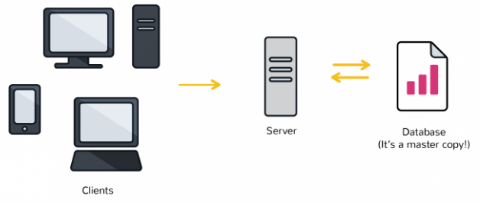
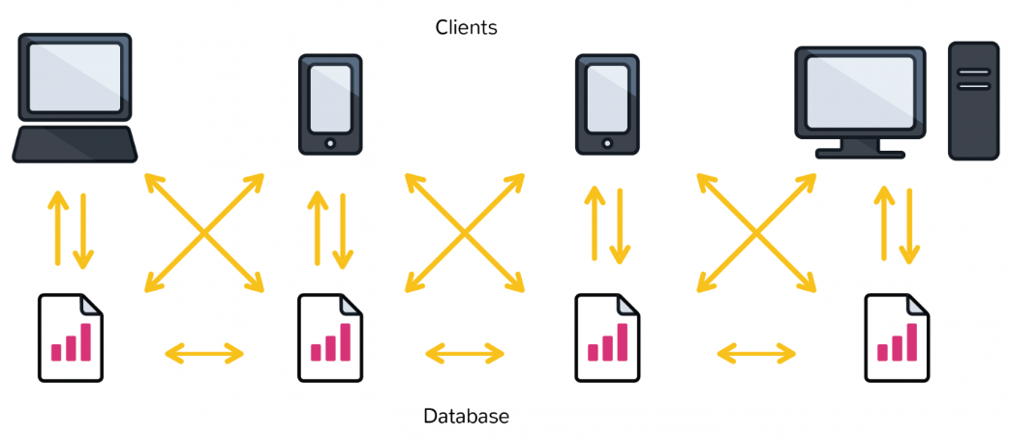
Distinction between databases and blockchain ledgers
Distinction between databases and blockchain ledgers
  It begins with architecture
Databases
Source: https://www.coindesk.com/information/what-is-the-difference-blockchain-and-database/
Blockchain ledgers
Notes:
A database running on the World Wide Web is most often using a client-server network architecture.
For a blockchain database, each participant maintains, calculates and updates new entries into the database. All nodes work together to ensure they are all coming to the same conclusions, providing in-built security for the network.

Slide 27
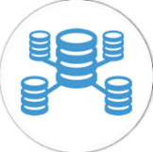
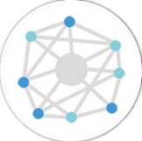
Distinction between databases and blockchain ledgers
Databases | Blockchains
Databases have admins & centralized control | No on is the admin or in-charge
Only entities with rights can access database | Anyone can access (public) blockchain
Only entities entitled to read or write can do so | Anyone with right proof of work can write on the blockchain
Databases are fast | Blockchains are slow
No history of records & ownership of digital records | History of records & ownership of digital records
VS
Source: https://coinsutra.com/blockchain-vs-database/
Notes:
This table summarizes the distinction between databases and blockchain ledgers.

Slide 28
Cryptography, hash functions and digital signatures
Cryptography: the encryption and decryption of data
  2 main cryptographic concepts used in Blockchain:
  - Hashing
  - Digital Signatures
  3 forms of encryption that are widely used:
Symmetric cryptography | Asymmetric cryptography | Hashing
Same password to encrypt & decrypt | one password to encrypt, the other to decrypt | Maps to fixed size
2 ways function | Passwords come by pair | 1 way function
Source: https://lisk.io/academy/blockchain-basics/how-does-blockchain-work/what-is-hashing
https://lisk.io/academy/blockchain-basics/how-does-blockchain-work/digital-signatures
Notes:
Hashing: the process of taking an input of any length and turning it into a cryptographic fixed output through a mathematical algorithm (Bitcoin uses SHA-256, for example).
Digital signatures: one of the main aspects of ensuring the security and integrity of the data that is recorded onto a blockchain, a standard part of most blockchain protocols, mainly used for securing transactions and blocks of transactions, transfers of sensitive information, software distribution, contract management and any other cases where detecting and preventing any external tampering is import.

Slide 29
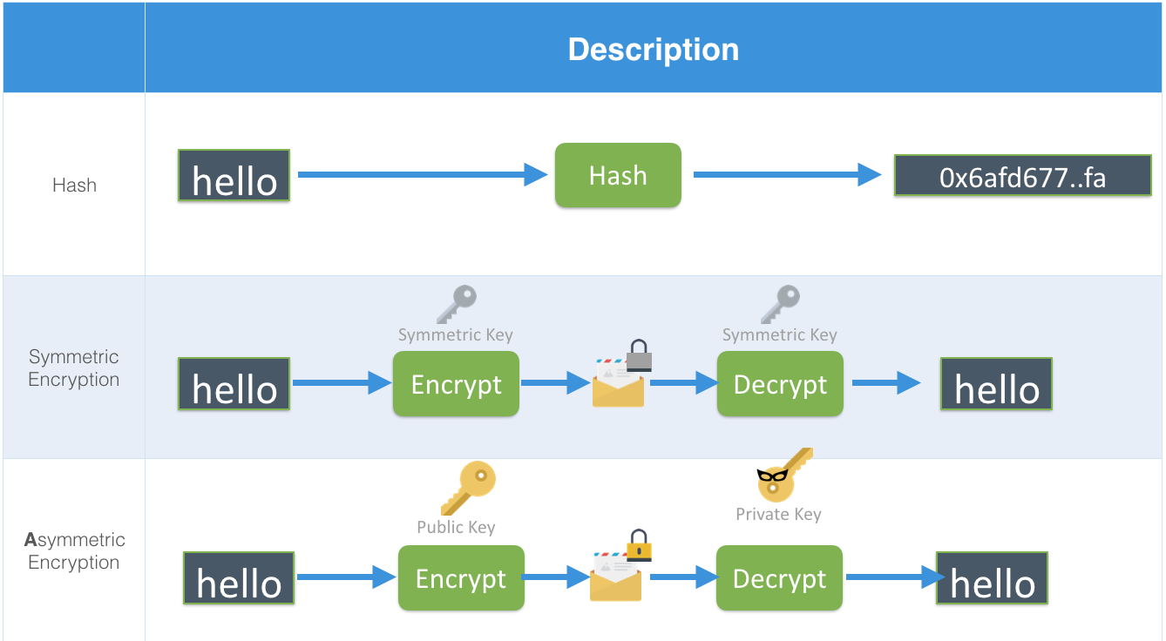
Cryptography, hash functions and digital signatures
Image source: Scorechain
Notes:
This slide and the next 3 slides explain how the Hash, Symmetric encryption, Asymmetric encryption work.
The hash function always produces a fixed length checksum (for example, the length of the hash of MD5 will always be 32 characters.)
Symmetric encryption uses the same key for encrypting and decrypting, Asymmetric encryption uses a key for encrypting and another key for decrypting.
Asymmetric encryption is safer than Symmetric encryption, so it is more often used in the information technology and blockchain technology.

Slide 30
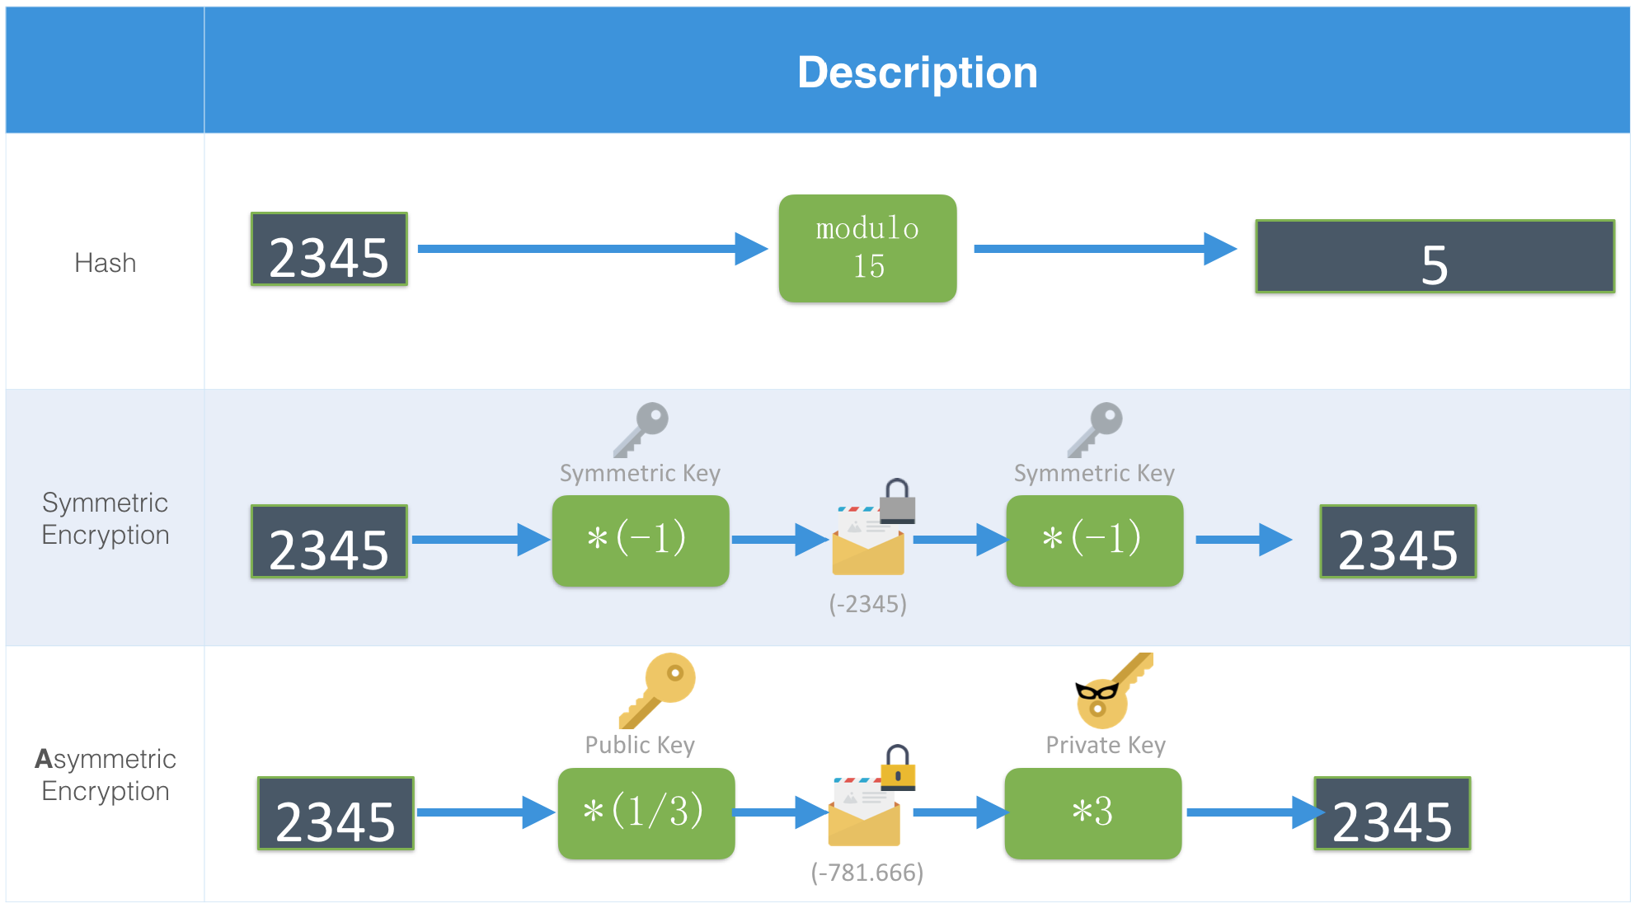
Cryptography, hash functions and digital signatures
Image source: Scorechain

Slide 31
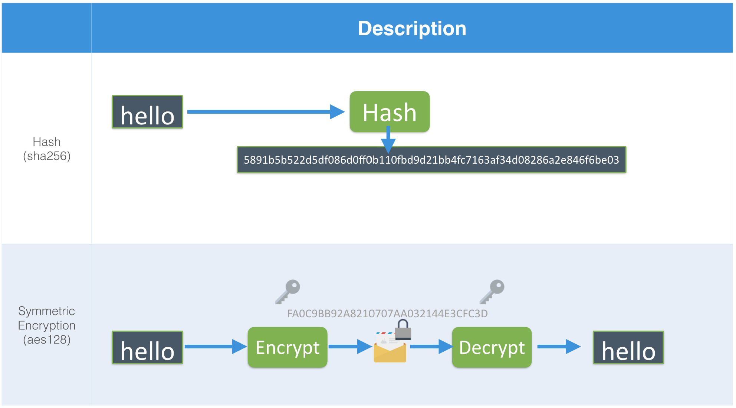
Cryptography, hash functions and digital signatures
Image source: Scorechain

Slide 32
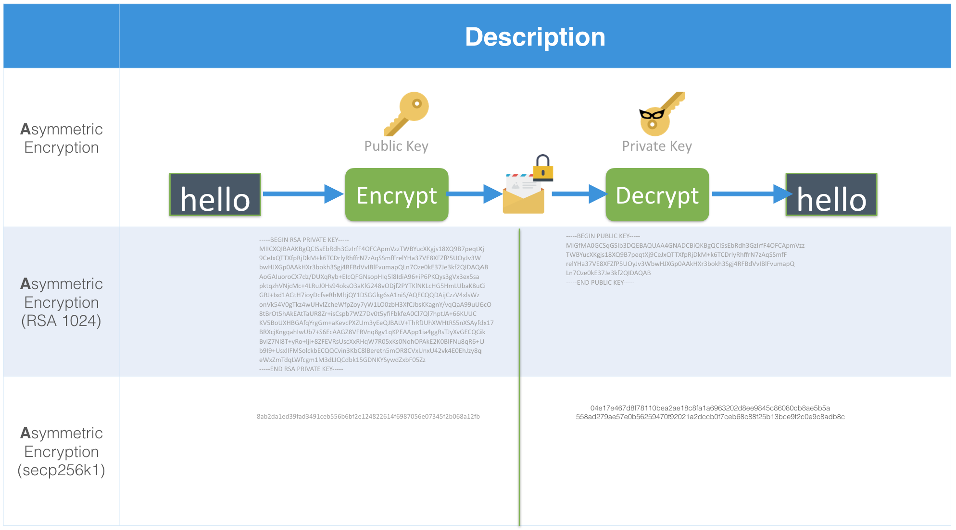
Cryptography, hash functions and digital signatures
Image source: Scorechain

Slide 33
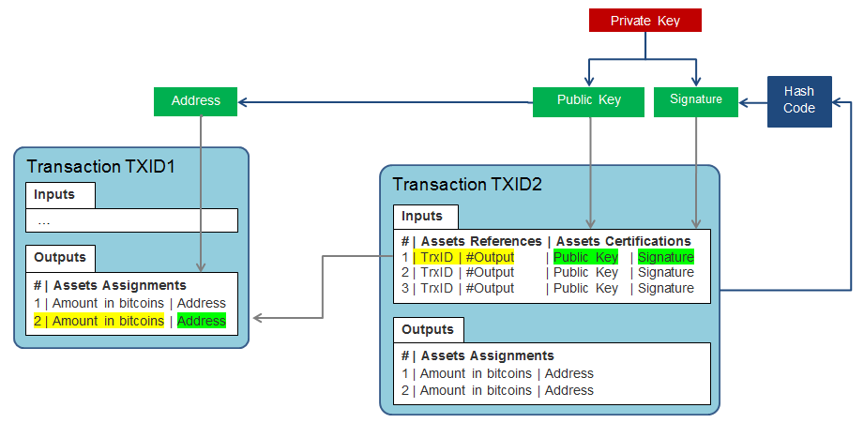
Cryptography, hash functions and digital signatures
Image source: https://pascalpares.gitbook.io/an-introduction-to-the-bitcoin-system/the-transactions/structure-of-a-transaction
Notes:
This diagram presents the structure of a transaction and the locks set with the user’s private keys, which shows the interest of cryptography for blockchain.

Slide 34
Consensus components
  Principles and paradigms of distributed systems
  Byzantine fault tolerance (BFT): the dependability of a fault-tolerant computer system, particularly distributed computing systems, where components may fail and there is imperfect information on whether a component has failed.
  The objective of BFT is to defend against failures of system components with or without symptoms that prevent other components of the system from reaching an agreement among themselves, where such an agreement is needed for the correct operation of the system.
  One example of BFT in use is bitcoin. The bitcoin network works in parallel to generate a blockchain with proof-of-work allowing the system to overcome Byzantine failures and reach a coherent global view of the system’s state.
Source: https://en.wikipedia.org/wiki/Byzantine_fault
Notes:
A Byzantine fault is any fault presenting different symptoms to different observers. A Byzantine failure is the loss of a system service due to a Byzantine fault in systems that require consensus.

Slide 35
Consensus components
  Blockchain consensus algorithms
  Behind every cryptocurrency, there’s a consensus algorithm. No consensus algorithm is perfect, but they each have their strengths. In the world of crypto, consensus algorithms exist to prevent double spending.
  Proof of Work (PoW)
  Proof of Stake (PoS)
  Delegated Proof of Stake (DPOS)
  Proof of Burn (PoB)
  Practical Byzantine fault tolerant Mechanism (PBFT)
  …
Source: https://www.newgenapps.com/blog/8-blockchain-consensus-mechanisms-and-benefits

Slide 36
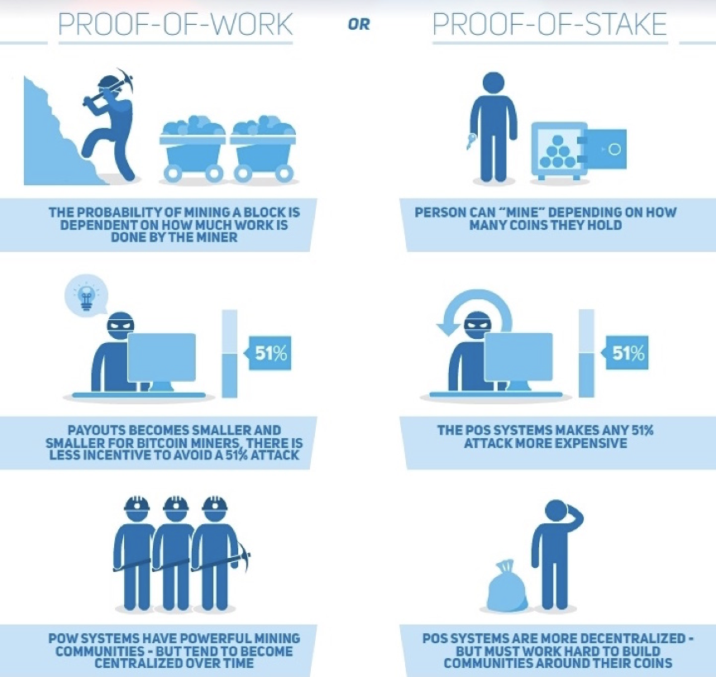
Consensus components
Image source: https://cointelegraph.com/storage/uploads/view/ea5b21f014547b4b44cf2dafcd76aad2.jpg
Notes:
This image explains the difference between proof-of-work and proof-of-stake.

Slide 37
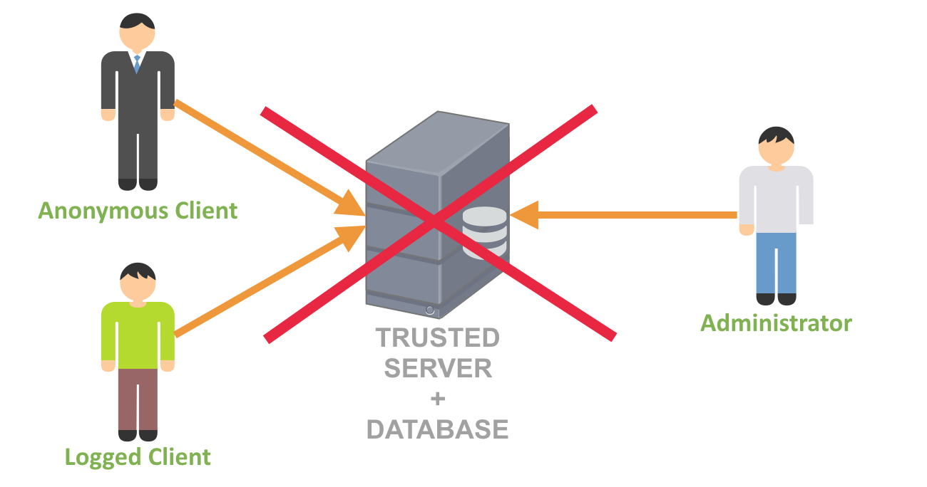
Consensus components
  Blockchain structure
  No more client/server architecture with name roles
Image source: Scorechain

Slide 38
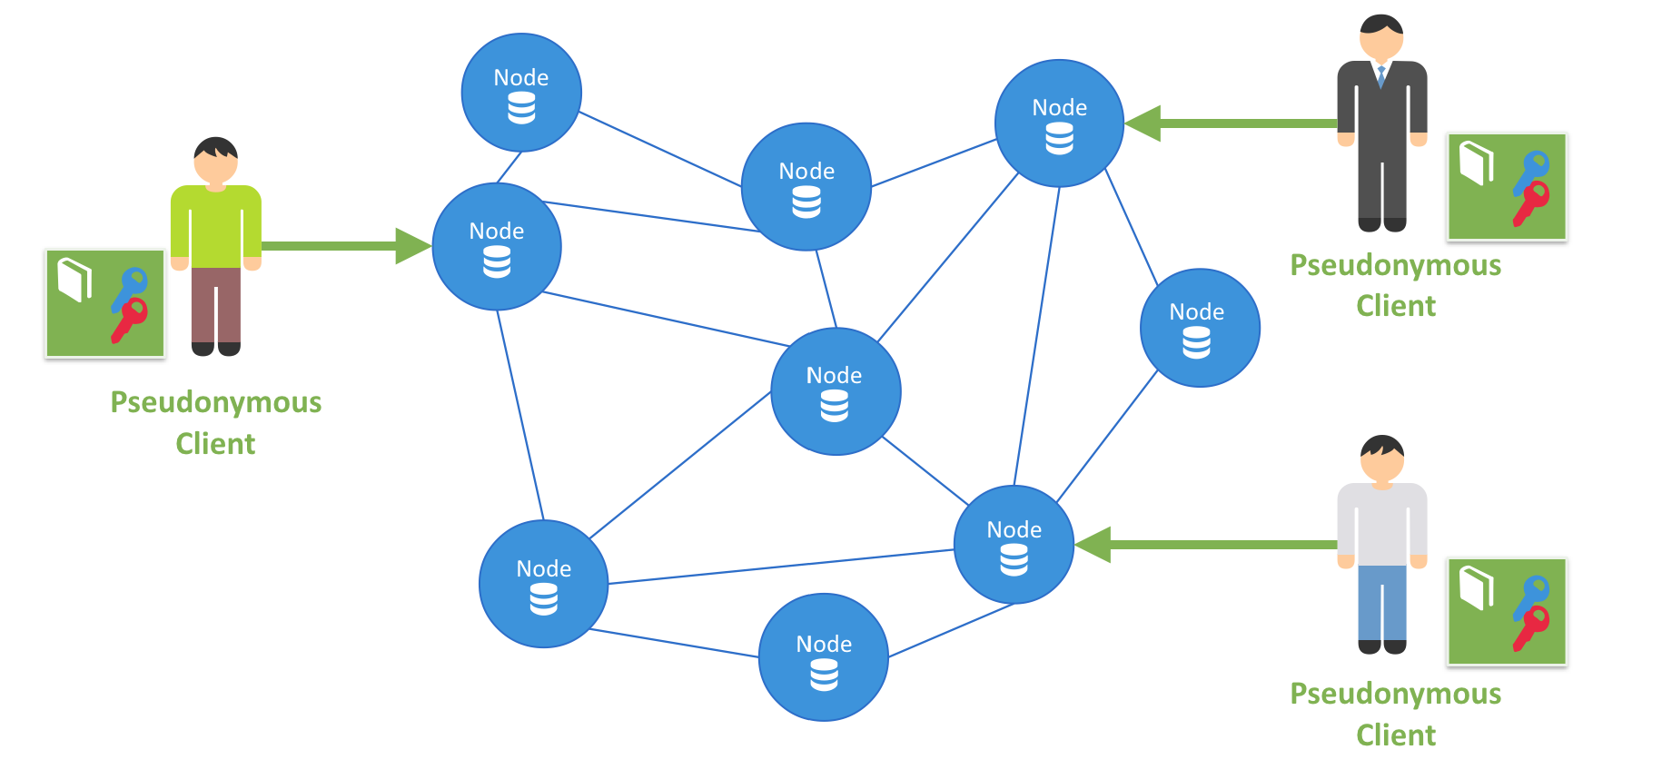
Consensus components
  Blockchain structure
  Peer-to-peer Architecture with pseudonymous client bearing key pairs. Each node as a database copy.
Image source: Scorechain

Slide 39
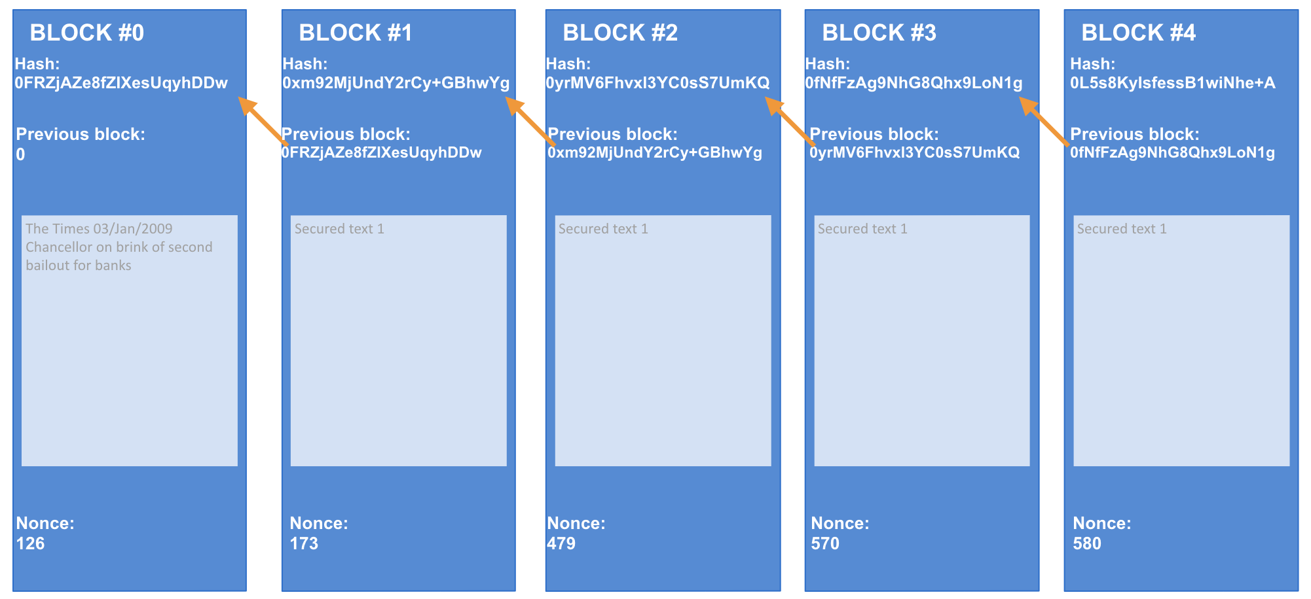
Consensus components
  Blockchain structure
  Data structure:
Image source: Scorechain

Slide 40
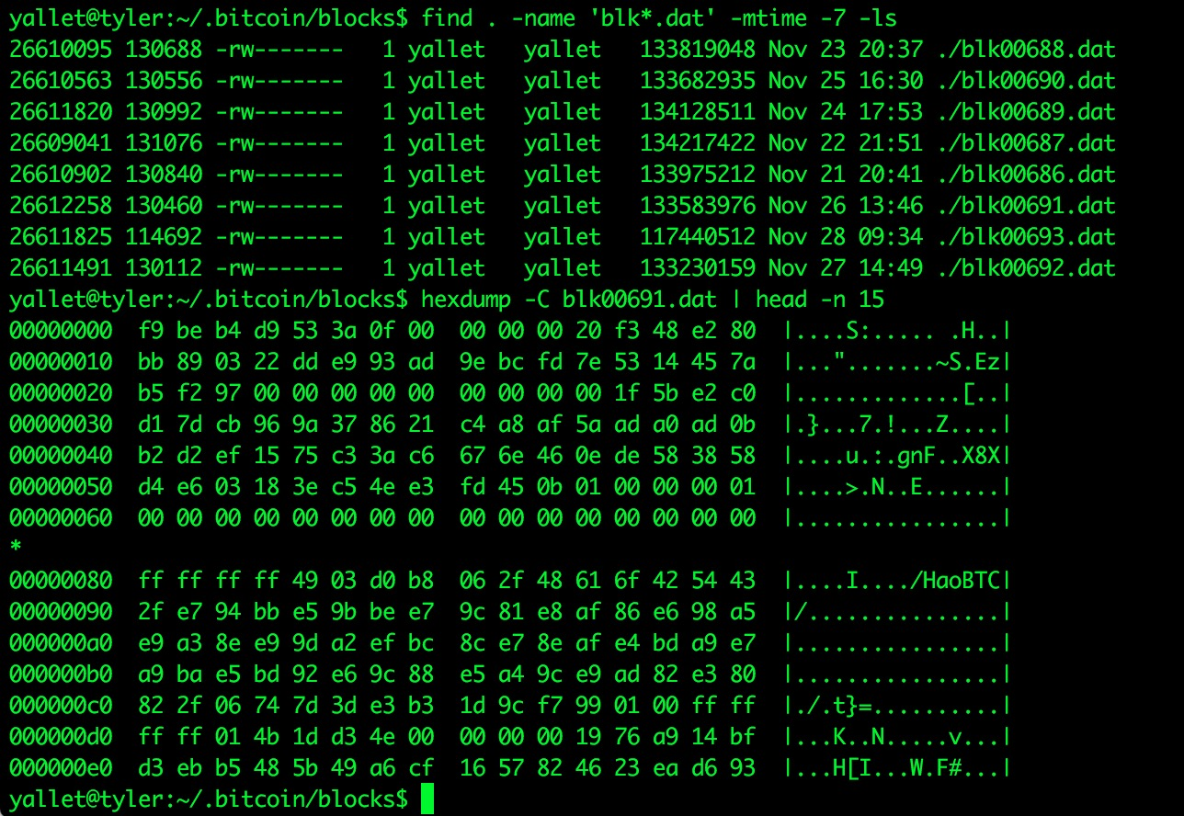
Consensus components
  Blockchain structure
  Blocks of data:
Image source: Scorechain
Notes:
Every block is stocked in a file, and this chart shows the header of a block containing a mining pool name: HaoBTC.

Slide 41
Consensus components
  Types of blockchain
  There mainly three types of Blockchains that have emerged after Bitcoin introduced Blockchain to the world.
  Public Blockchain:
  no one in charge, anyone can participate in reading/writing/auditing the blockchain (i.e. Bitcoin, Litecoin, etc.)
  Private Blockchain:
  a private property of an individual or an organization, there is one in charge of important things such as read/write or whom to selectively give access to read or vice versa (i.e. Bankchain)
  Consortium or Federated Blockchain:
  More than one in charge. A group of companies or representative individuals come together and make decisions for the best benefit of the whole network (i.e. r3, EWF)
Soucre: https://coinsutra.com/different-types-blockchains
Notes:
You can run your own “private” blockchain. You can edit the code, for example you can run your custom Ethereum blockchain (mining difficulty, updates…). Some parts of code are useless (crypto-currency useless without crypto-economics). Without “network effect”, a private blockchain is useless.

Slide 42
Smart Contract Theory and architecture
Smart Contract Theory
  A computer protocol designed digitally facilitate, verify, or enforce the negotiation or performance of a contract.
  It allows the performance of credible transactions without the third parties.
  The transactions are traceable and irreversible.
Source: https://en.wikipedia.org/wiki/Smart_contract

Slide 43
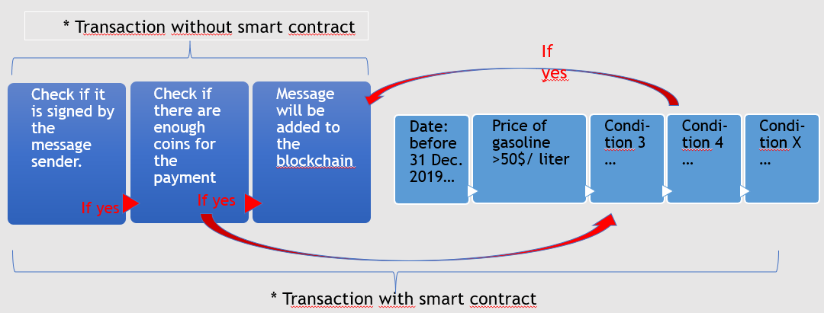
Smart Contract Theory and architecture
Smart Contract architecture
Image source: Scorechain

Slide 44
Architectures and decentralized autonomous systems
DAO (Decentralized Autonomous Organization)
  An organization represented by rules encoded as a computer program, which is transparent, controlled by shareholders and not influenced by a central government.
  It's notionally like the example for getting funds for a small conference, except that it includes much more. Members buy shares in the DAO and can vote on things according to the number of shares they have. The dreamers have the idea they'll replace Democracy and run entire countries this way.
  The DAO was the largest crowdfunding in history, having raised over $150m from more than 11,000 enthusiastic members. (ICO)
  A DAO’s financial transaction record and program rules are maintained on a blockchain.
Source:
https://blog.erratasec.com/2016/06/etheriumdao-hack-similfied.html#.XHbF3VNKhPN
https://medium.com/@nasirhm/understanding-the-dao-attack-9328a230243

Slide 45
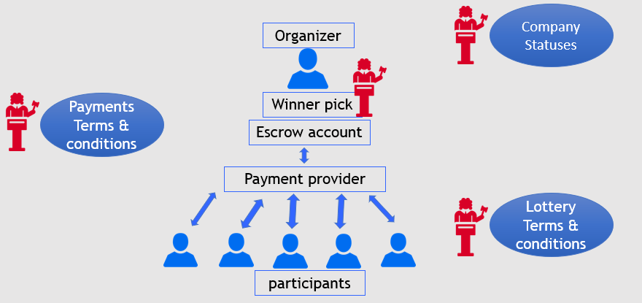
Smart contract application
Example 1: Lottery
  Lottery without smart contract
Source: https://www.slideshare.net/ThomasCharlesVanderstraeten/ethereum-smart-contract-101-with-cryptizensio
Notes:
Lottery without smart contract: a complex ecosystem of stakeholders, laws, processes and documents to embed trust in interactions, and protect people in case of breaches.

Slide 46
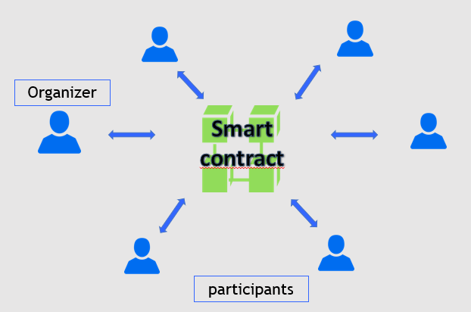
Smart contract application
Example 1: Lottery
  Lottery with smart contract
Source: https://www.slideshare.net/ThomasCharlesVanderstraeten/ethereum-smart-contract-101-with-cryptizensio
Notes:
Lottery with smart contract: smart contract technology allows all the participants to interact in a trustless way, where technology prevents breaches of agreements.

Slide 47
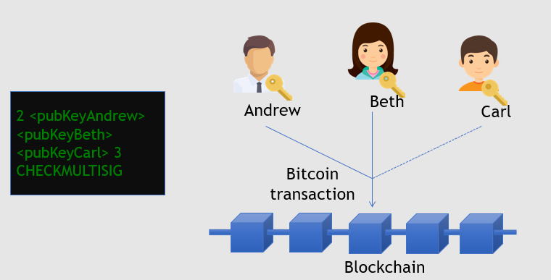
Smart contract application
Example 2-1: Group wallets
  Enforcing at least 2 out of 3 people of a group to agree to create a valid transaction
Source: https://www.slideshare.net/FedericoTenga/state-smart-contract-ttechnologies

Slide 48
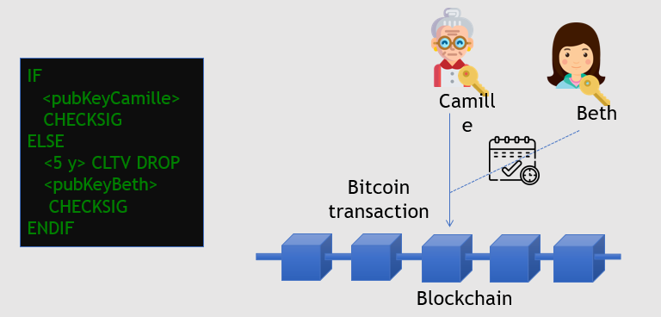
Smart contract application
Example 2-2: Heritage wallets
  Enforcing that a transaction must be signed either by Camille OR by Beth after 5 years
Source: https://www.slideshare.net/FedericoTenga/state-smart-contract-ttechnologies

Slide 49
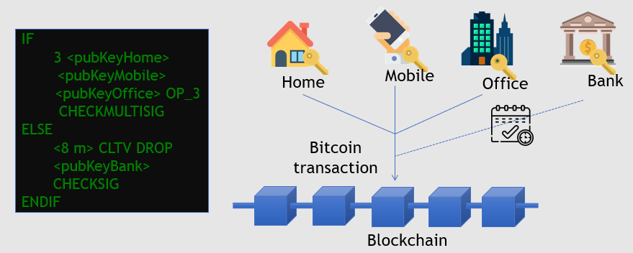
Smart contract application
Example 2-3: Secure storage
  Enforcing that a transaction must be signed by either 3 devices in different locations OR a recovery key deposited in the bank after 8 months
Source: https://www.slideshare.net/FedericoTenga/state-smart-contract-ttechnologies

Slide 50
Existing blockchain applications, related structures and architectures
ERC-20
  Proposed on November 19, 2015 by Fabian Vogelsteller.
  A technical standard used for smart contracts on the Ethereum blockchain for implementing tokens. (ERC: Ethereum Request for Comment, 20: the number that was assigned to this request.)
  It defines a common list of rules that an Ethereum token has to implement, allowing developers to program how new tokens will function within the Ethereum ecosystem. These rules include how the tokens are transferred between addresses and how data within each token is accessed.
  + 142,200 ERC-20 token contracts (as of November 19, 2018): EOS, Bancor, Qash, etc…
Source: https://en.wikipedia.org/wiki/ERC-20

Slide 51
Existing blockchain applications, related structures and architectures
ERC-721: a class of unique tokens
  A free, open standard that describes how to build non-fungible or unique tokens on the Ethereum blockchain. While most tokens are fungible (every token is the same as every other token, i.e.ERC-20), ERC-721 tokens are all unique.
  It defines a minimum interface a smart contract must implement to allow unique tokens to be managed, owned and traded.
ERC-725: Ethereum Identity Standard
  A proposed standard for blockchain-based identity which lives on the Ethereum blockchain.
  It describes proxy smart contracts that can be controlled by multiple keys and other smart contracts, it can describe humans, groups, objects and machines.
  Users should be able to own and manage their identity instead of ceding ownership of identity to centralized organizations.
Source:
http://erc721.org/
https://erc725alliance.org/

