Slide 1
Principles of Artificial Intelligence and Machine Learning
Principles of Artificial Intelligence and
Machine Learning
A. Chandra Shaker

Slide 2
Principles of Artificial Intelligence and Machine Learning
Intelligent Agents
  Agents and Environment
  Structure of Agents

Slide 3
Principles of Artificial Intelligence and Machine Learning
  Agents and Environment

Slide 4
Principles of Artificial Intelligence and Machine Learning
Agents
Agent: anything that perceives and acts on its environment
Human agent: eyes, ears, and other organs for sensors; hands, legs, mouth, and other body parts for actuators
Robotic agent: cameras and infrared range finders for sensors; various motors for actuators

Slide 5
Principles of Artificial Intelligence and Machine Learning
AI: study of rational agents
A rational agent carries out an action with the best outcome after considering past and current percepts

Slide 6
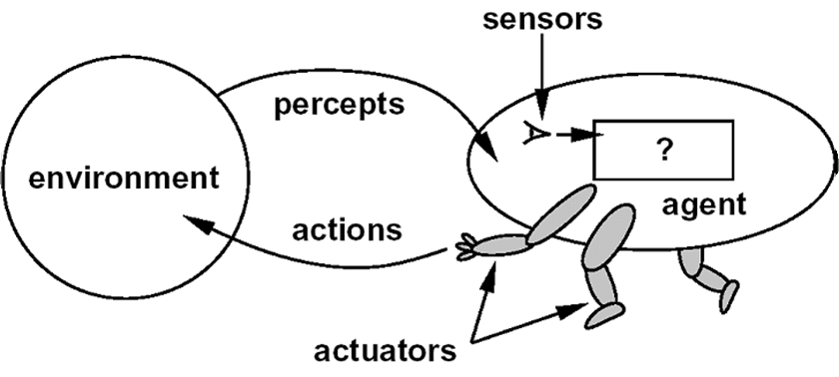
Principles of Artificial Intelligence and Machine Learning

Slide 7
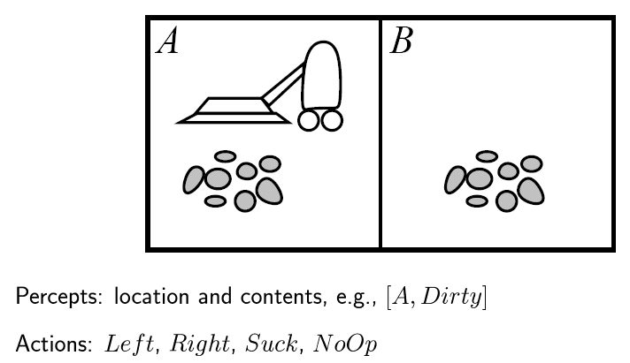
Principles of Artificial Intelligence and Machine Learning
Vacuum-cleaner world

Slide 8
Principles of Artificial Intelligence and Machine Learning
Agent Function
a = F(p)
where p is the current percept, a is the action carried out, and F is the agent function
F maps percepts to actions
F: P → A
where P is the set of all percepts, and A is the set of all actions
In general, an action may depend on all percepts observed so far, not just the current percept.

Slide 9
Principles of Artificial Intelligence and Machine Learning
So a_{k} = F(p₀ p₁ p₂ …p_{k})
where p₀ p₁ p₂ …p_{k} is the sequence of percepts observed to date, a_{k} is the resulting action carried out
F now maps percept sequences to action
F: P* → A

Slide 10
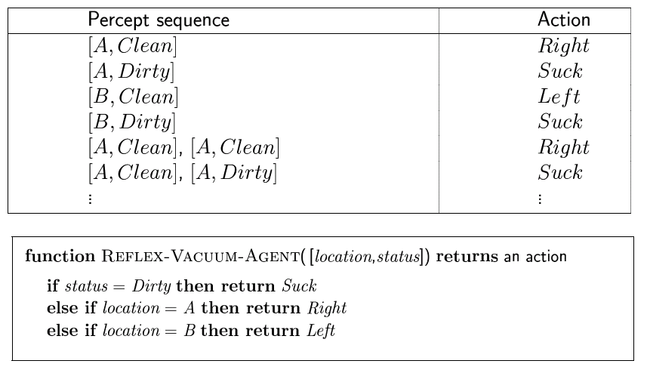
Principles of Artificial Intelligence and Machine Learning
A Vacuum-cleaner agent

Slide 11
Principles of Artificial Intelligence and Machine Learning
Specifying the Task Environment
PEAS
Performance Measure: captures agent’s aspiration
Environment: context, restrictions
Actuators: indicates what the agent can carry out
Sensors: indicates what the agent can perceive

Slide 12
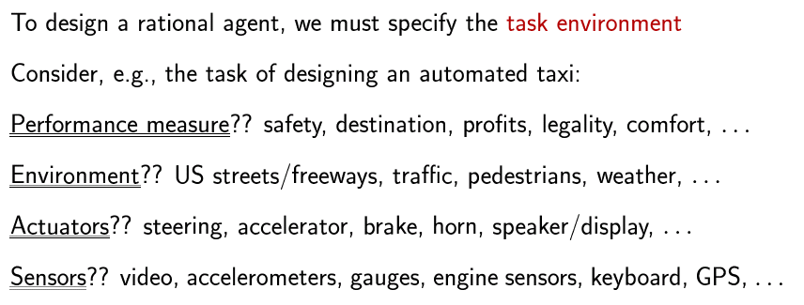
Principles of Artificial Intelligence and Machine Learning

Slide 13
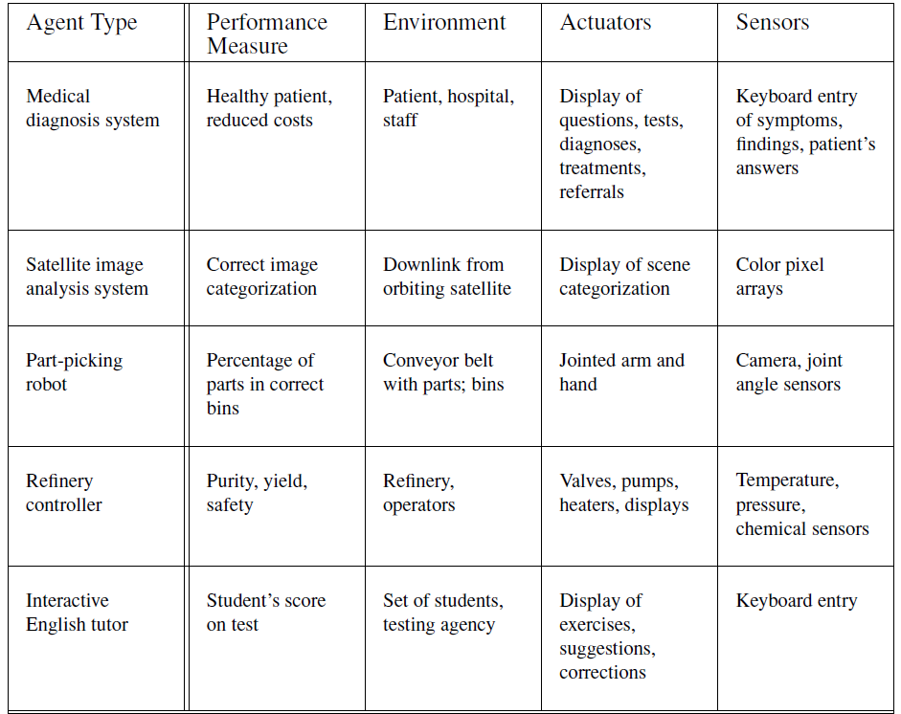
Principles of Artificial Intelligence and Machine Learning

Slide 14
Principles of Artificial Intelligence and Machine Learning
Properties of Environments
Fully versus partially observable
Deterministic versus stochastic
Episodic versus sequential
Static versus dynamic
Discrete versus continuous
Single agent versus multiagent

Slide 15
Principles of Artificial Intelligence and Machine Learning
Accessible vs. inaccessible (or) fully observable vs. partially observable
  If an agent‘s sensors give it access to the complete state of the environment at each point in time, then we say that the task environment is fully observable. Fully observable environments are convenient because the agent need not maintain any internal state to keep track of the world.
  An environment might be partially observable because of noisy and inaccurate sensors or because parts of the state are simply missing from the sensor data.

Slide 16
Principles of Artificial Intelligence and Machine Learning
Deterministic vs. non-deterministic (or) stochastic
  If the next state of the environment is completely determined by the current state and the action executed by the agent, then the environment is deterministic; otherwise, it is stochastic.
  In principle, an agent need not worry about uncertainty in a fully observable, deterministic environment. If the environment is partially observable, however, then it could appear to be stochastic.
Episodic vs. non-episodic (or) sequential
  In an episodic environment, the agent‘s experience is divided into atomic episodes. Each episode consists of its own percepts and actions and it does not depend on the previous episode.

Slide 17
Principles of Artificial Intelligence and Machine Learning
Episodic vs. non-episodic (or) sequential
  In an episodic environment, the agent‘s experience is divided into atomic episodes. Each episode consists of its own percepts and actions and it does not depend on the previous episode.
  In sequential environments, the current decision could affect all future of decisions. Eg. Chess and taxi driving.
  Episodic environments are much simpler than sequential environments because the agent does not need to think ahead.
Static vs. dynamic
  If the environment is changing for agent‘s action then the environment is dynamic for that agent otherwise it is static.

Slide 18
Principles of Artificial Intelligence and Machine Learning
  If the environment does not change for some time, then it changes due to agent‘s performance is called semi dynamic environment.
  E.g. Taxi driving is dynamic.
  Chess is semi dynamic.
  Crossword puzzles are static.
Discrete vs. continuous
  If the environment has limited number of distinct, clearly defined percepts and actions then the environment is discrete. E.g. Chess
  If the environment changes continuously with range of value the environment is continuous. E.g. Taxi driving.
Single agent vs. multiagent

Slide 19
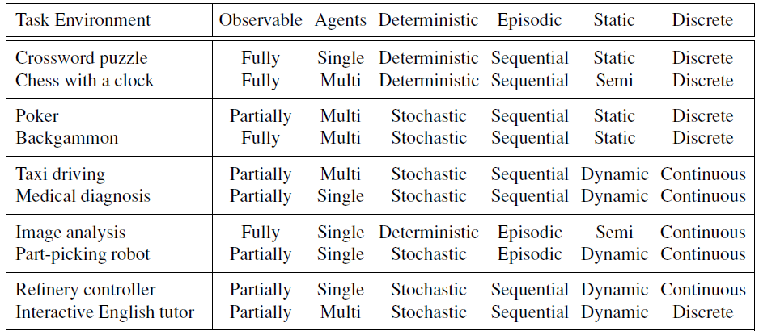
Principles of Artificial Intelligence and Machine Learning

Slide 20
Principles of Artificial Intelligence and Machine Learning
  Structure of Agents

Slide 21
Principles of Artificial Intelligence and Machine Learning
Agent = architecture + program
architecture
  device with sensors and actuators
  e.g., A robotic car, a camera, a PC, …
program
  implements the agent function on the architecture

Slide 22
Principles of Artificial Intelligence and Machine Learning
Types of Agents
Reflex Agent
Model-based Agent (Reflex Agent with State)
Goal-based Agent
Utility-Based Agent
Learning Agent

Slide 23
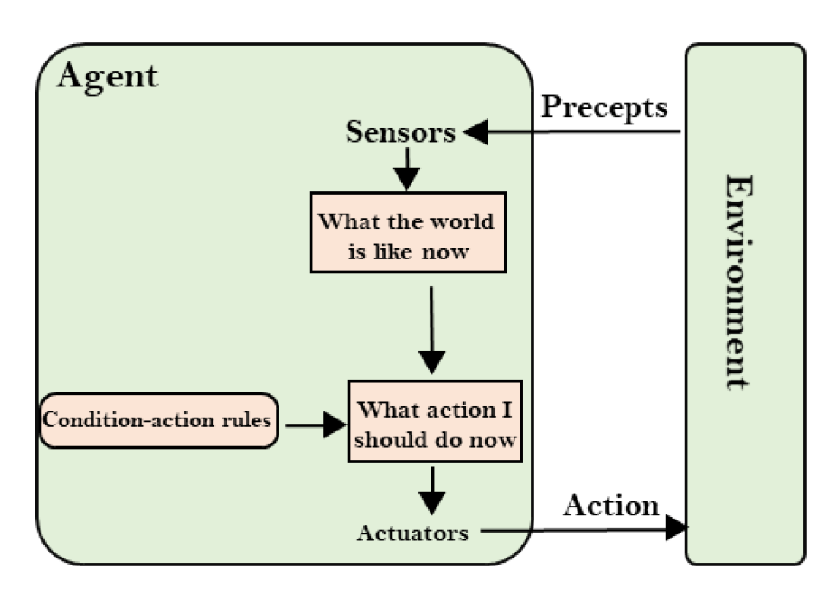
Principles of Artificial Intelligence and Machine Learning
Reflex Agent

Slide 24
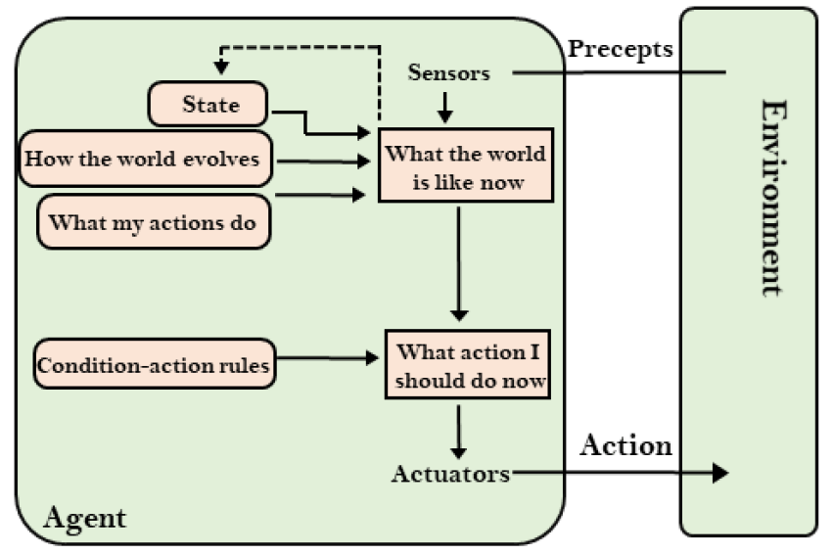
Principles of Artificial Intelligence and Machine Learning
Model-based Agent (Reflex Agent with State)

Slide 25
Principles of Artificial Intelligence and Machine Learning
State Management
Reflex agent with state
  Incorporates a model of the world
  Current state of its world depends on percept history
  Rule to be applied next depends on resulting state
state’ ← next-state(state, percept)
action ← select-action(state’, rules)

Slide 26
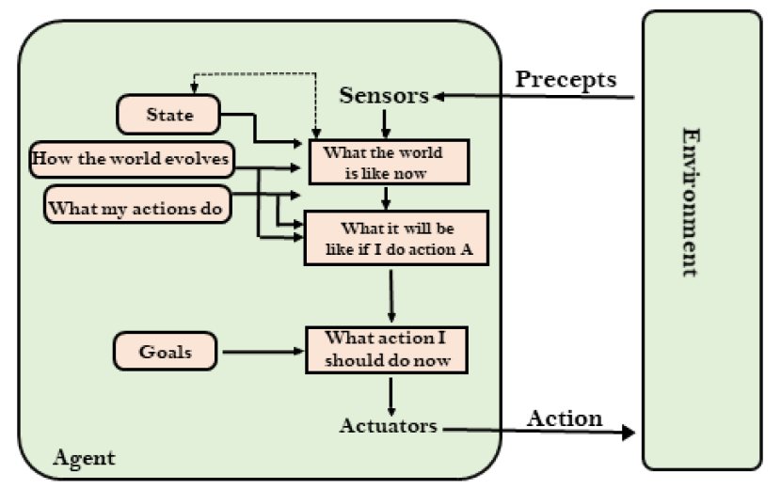
Principles of Artificial Intelligence and Machine Learning
Goal-based Agent

Slide 27
Principles of Artificial Intelligence and Machine Learning
Incorporating Goals
Rules and “foresight”
  Essentially, the agent’s rule set is determined by its goals
  Requires knowledge of future consequences given possible actions
Can also be viewed as an agent with more complex state management
  Goals provide for a more sophisticated
  next-state function

Slide 28
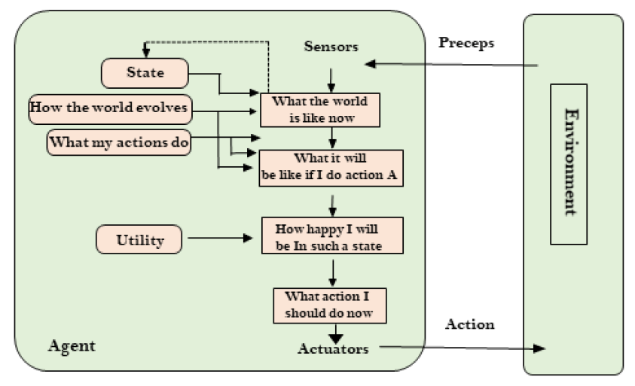
Principles of Artificial Intelligence and Machine Learning
Utility-based Agent

Slide 29
Principles of Artificial Intelligence and Machine Learning
Incorporating Performance
May have multiple action sequences that arrive at a goal
Choose action that provides the best level of “happiness” for the agent
Utility function maps states to a measure
  May include tradeoffs
  May incorporate likelihood measures

Slide 30
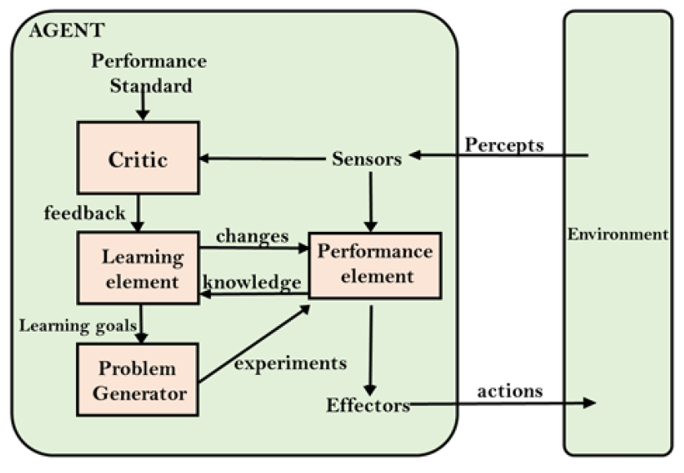
Principles of Artificial Intelligence and Machine Learning
Learning Agent

Slide 31
Principles of Artificial Intelligence and Machine Learning
Incorporating Learning
Can be applied to any of the previous agent types
  Agent <-> Performance Element
Learning Element
  Causes improvements on agent/ performance element
  Uses feedback from critic
  Provides goals to problem generator

