Slide 1
Blockchain Technology
A. Chandra Shaker

Slide 2
Module 1:
Introduction to Blockchain Technology

Slide 3
Week 2: Blockchain Structure
Objectives:
  Understand the basic structure of blocks in a blockchain.
  Learn how transactions are added to blocks.
  Explore the process of mining and block validation.
  Delve into the role of hashing and cryptography in securing the blockchain.

Slide 4
What is a Block in Blockchain?
Definition:
  A block is a collection of data that is stored together in a blockchain.
  Each block contains a list of transactions, a timestamp, and a reference to the previous block.
Key Points:
  Data: Contains information like transactions, contracts, or other records.
  Hash: A unique identifier for the block, created using cryptographic algorithms.
  Previous Block Hash: Links the current block to the previous one, forming a chain.

Slide 5
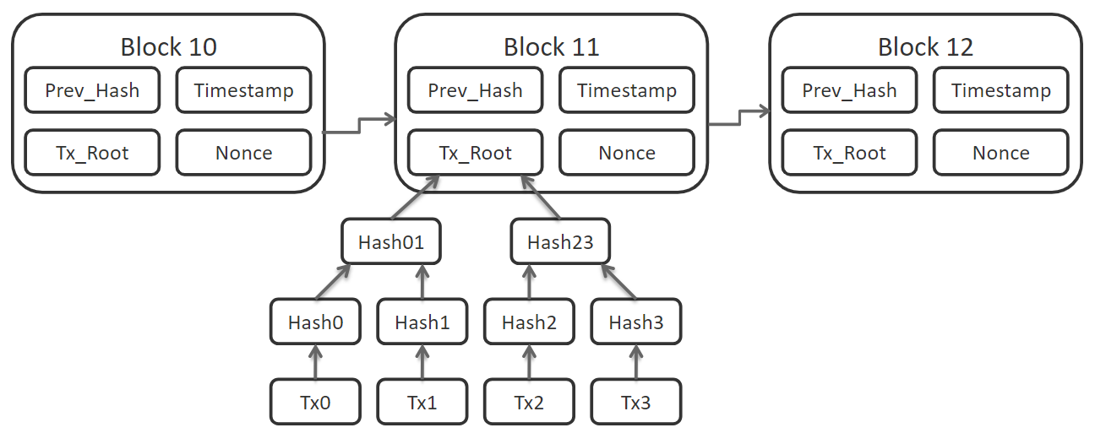
How Blocks are Linked in a Blockchain?
Block Structure:
  Each block references the hash of the previous block, creating a secure and immutable chain.
  This chaining mechanism ensures that altering any block would require altering all subsequent blocks, making the blockchain tamper-proof.

Slide 6
What is Mining?
Definition:
  Mining is the process of validating and adding new transactions to the blockchain.
  It involves solving complex cryptographic puzzles to find a valid hash for the new block.
Mining Process:
  Transaction Broadcasting: New transactions are broadcasted to the network.
  Transaction Verification: Nodes in the network verify the transactions.
  Puzzle Solving: Miners compete to solve a cryptographic puzzle.
  Block Creation: The first miner to solve the puzzle creates a new block and adds it to the blockchain.
  Reward: The miner receives a reward (e.g., cryptocurrency) for their work.

Slide 7
Understanding Hashing
Definition:
  A hash is a fixed-size string of characters that uniquely represents data.
  Hashing is used in blockchain to secure data and ensure integrity.
Properties of Hashing:
  Deterministic: Same input will always produce the same output.
  Fast Computation: Hashes can be quickly generated.
  Pre-Image Resistance: It’s difficult to reverse-engineer the original data from its hash.
  Small Changes in Input Produce Large Changes in Output: A minor change in data drastically changes the hash.

Slide 8
Role of Cryptography in Blockchain
Cryptography in Blockchain:
  Cryptography ensures the security, privacy, and integrity of data in the blockchain.
  Two main types of cryptography used in blockchain:
    Symmetric Cryptography: Same key is used for both encryption and decryption.
    Asymmetric Cryptography: Involves a pair of keys—one public and one private.
Public and Private Keys:
  Public Key: Can be shared openly, used to encrypt data.
  Private Key: Kept secret, used to decrypt data.
  In blockchain, the private key is used to sign transactions, ensuring that only the owner can authorize transactions.

Slide 9
Transaction Verification and Validation
Transaction Process:
  Broadcasting: A user initiates a transaction, which is broadcast to the network.
  Validation by Nodes: Network nodes verify the transaction's legitimacy (e.g., checking digital signatures).
  Inclusion in Block: Once validated, the transaction is included in a new block by a miner.
Double-Spending Problem:
  Blockchain solves the double-spending problem by ensuring that once a transaction is added to a block, it cannot be altered or spent again.

Slide 10
Importance of Blockchain Immutability
Immutability:
Once data is written into a block and the block is added to the chain, it cannot be changed without altering every subsequent block.
This makes the blockchain highly resistant to tampering.
Security Implications:
Immutability ensures the integrity and reliability of the data stored in the blockchain.
It's one of the key factors behind the trust in blockchain technology.

Slide 11
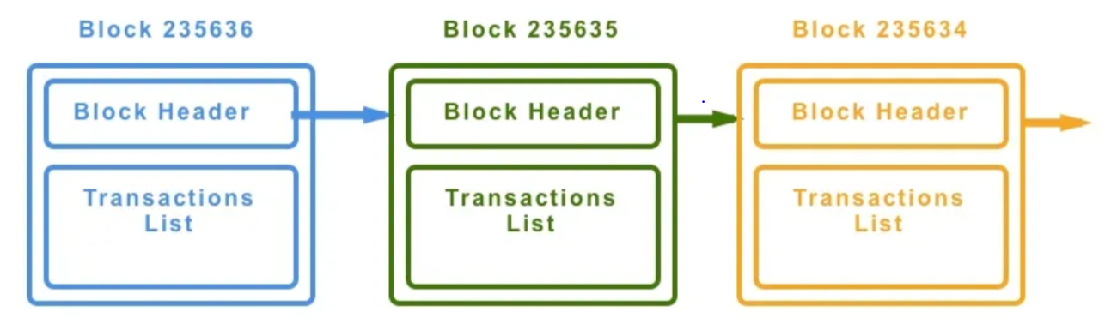
Real-World Example: Bitcoin's Blockchain Structure
Bitcoin Blockchain:
  Uses a Proof of Work (PoW) consensus mechanism.
  Block Size: 1 MB (can hold about 2000 transactions).
  Block Time: Approximately 10 minutes.
  Each block in the Bitcoin blockchain contains:
    Block Header: Includes metadata like the previous block hash, timestamp, and a nonce.
    Transaction List: A list of all transactions included in the block.

Slide 12
Challenges and Considerations
Challenges in Blockchain Structure:
Scalability: Limited number of transactions per second due to block size and block time.
Energy Consumption: High energy usage in mining, especially in PoW systems.
Forks: Occur when there is a disagreement in the network about the next block to add, leading to temporary splits in the blockchain.
Considerations:
Different blockchains may use varying approaches to address these challenges (e.g., alternative consensus mechanisms).

Slide 13
Key Takeaways:
  Understanding the structure of a block and how blocks are linked is fundamental to grasping blockchain technology.
  Hashing and cryptography play critical roles in securing the blockchain.
  Mining is the process by which transactions are validated and added to the blockchain.

