Slide 1

Uniform-cost search
A. Chandra Shaker

Slide 2
Uninformed Search Strategies
  Depth-first search
  Breadth-first search
  Uniform-cost search

Slide 3
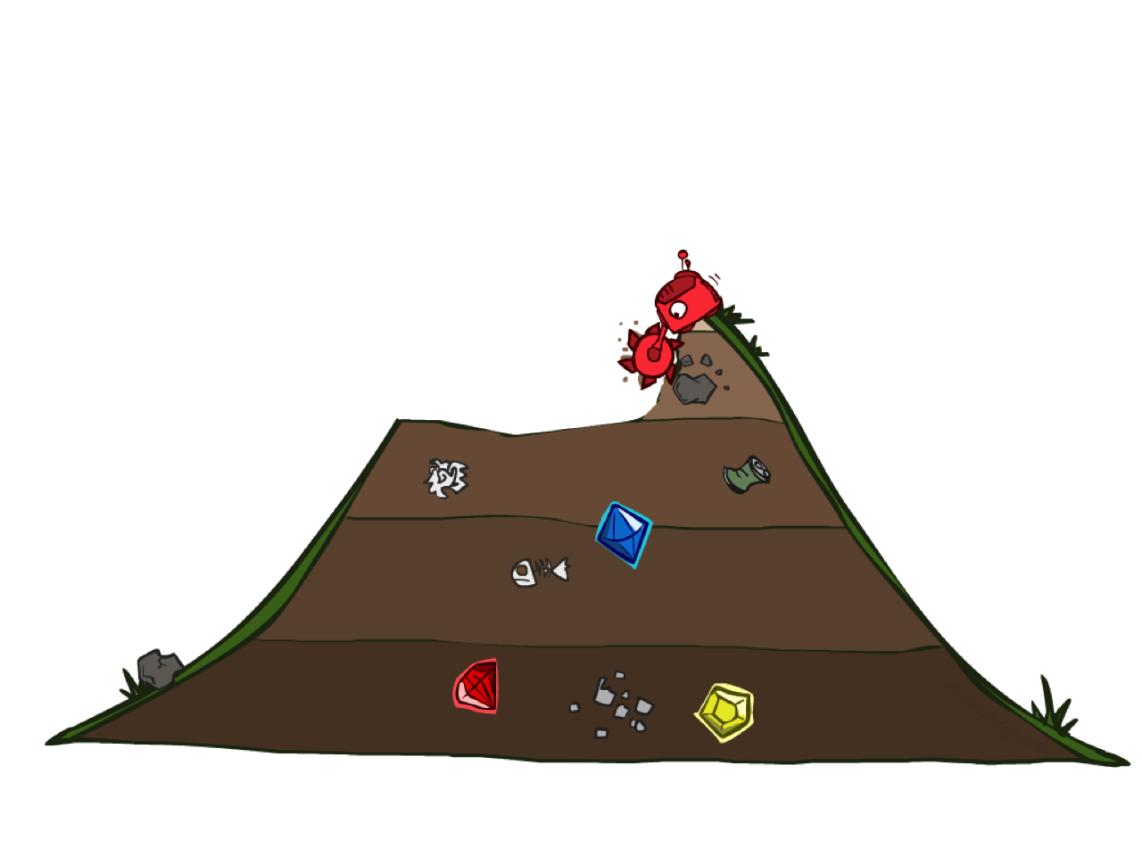
  Uniform-cost search

Slide 4
The root node is expanded first, and then the next node to be expanded is selected as the lowest cost node on the fringe rather than the lowest depth node i.e. g (n) = path cost.
Breadth-first search is equivalent to Uniform cost search when g(n) = DEPTH(n).
Advantage: Guaranteed to find the single solution at minimum path cost.
Disadvantage: Only suitable for smallest instances problem.

Slide 5
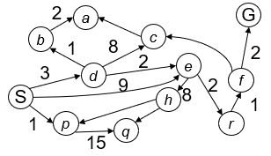
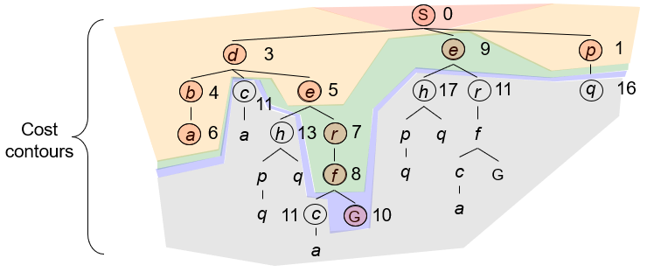
Strategy: expand a cheapest node first:
Implementation: Fringe is a priority queue (priority: cumulative cost)

Slide 6
5
2
[5]
[2]
1
4
1
7
[6]
[3]
[9]
[9]
Goal state
4
5
[x] = g(n)
path cost of node n
[7]
[8]

Slide 7
5
2
[5]
[2]

Slide 8
5
2
[5]
[2]
1
7
[3]
[9]

Slide 9
5
2
[5]
[2]
1
7
[3]
[9]
4
5
[7]
[8]

Slide 10
5
2
[5]
[2]
1
4
1
7
[6]
[3]
[9]
[9]
4
5
[7]
[8]

Slide 11
5
2
[5]
[2]
Goal state path cost g(n)=[6]
1
4
1
7
[3]
[9]
[9]
4
5
[7]
[8]

Slide 12
5
2
[5]
[2]
1
4
1
7
[6]
[3]
[9]
[9]
4
5
[7]
[8]

Slide 13
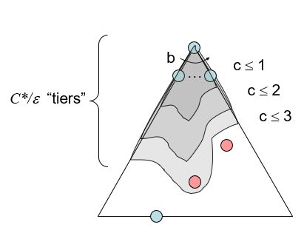
Uniform Cost Search (UCS) Properties
What nodes does UCS expand?
  Processes all nodes with cost less than cheapest solution!
  If that solution costs C* and arcs cost at least ε , then the “effective depth” is roughly C*/ε
  Takes time O(b^{C*/ε}) (exponential in effective depth)
How much space does the fringe take?
  Has roughly the last tier, so O(b^{C*/ε})
Is it complete?
  Assuming best solution has a finite cost
  and minimum arc cost is positive, yes!
Is it optimal?
  Yes!

Slide 14
Depth-limited search
The problem of unbounded trees can be alleviated by supplying depth-first search with predetermined depth limit L. i.e., nodes at depth L are treated as if they have no successors. This approach is called depth-limited search. The maximum level of depth depends on the number of states.

Slide 15
Iterative deepening search
It is a general strategy that sidesteps the issue of choosing the best depth limit by trying all possible depth limits. It combines the benefits of depth-first and breadth-first search.

Slide 16
Bidirectional search
It is a strategy that simultaneously searches both the directions i.e. forward from the initial state and backward from the goal, and stops when the two searches meet in the middle. It is implemented by having one or both of the searches check each node before it is expanded to see if it is in the fringe of the order search tree; if so, a solution has been found.

Slide 17

SUBSCRIBE
For more courses visit
https://chandrashaker.com/courses

