Slide 1


Artificial Intelligence
Depth-first search
A. Chandra Shaker
Thank You All Subscribers

Slide 2
Depth-first search
A. Chandra Shaker

Slide 3
Uninformed Search Strategies
  Depth-first search
  Breadth-first search
  Uniform-cost search

Slide 4
In general the Search Strategies are classified into:
  Uninformed search (or) Blind search (or) Exhaustive search
  Informed search (or) Heuristic search
Uninformed search (Blind search) | Informed search (Heuristic search)
No information about the number of steps (or) path cost from the current state to goal state | The path cost from the current state to goal state is calculated, to select the minimum path cost as the next state.
Less effective in search method | More effective
Problem to be solved with the given information | Additional information can be added as assumption to solve the problem
E.g. a)Breadth first search b)Uniform cost search c) Depth first search d) Depth limited search e) Interactive deepening search f) Bi-directional search | E.g. a) Best first search b) Greedy search c) A* search

Slide 5
  Depth-first search

Slide 6
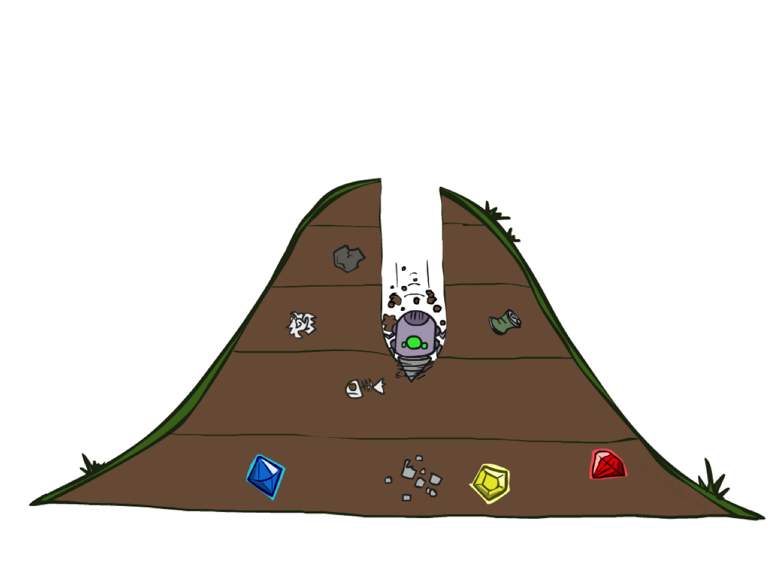
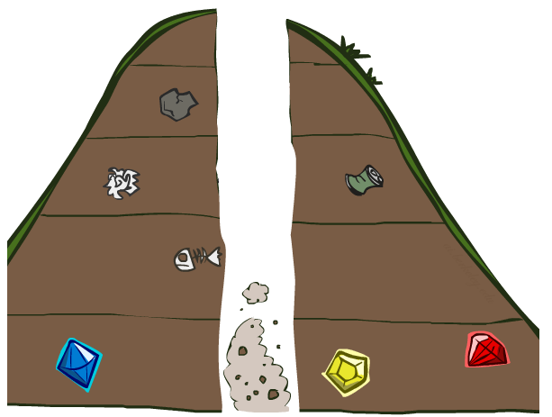
  Depth-first search

Slide 7
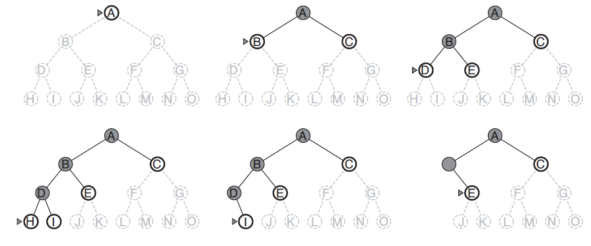
Depth-first search on a binary tree.

Slide 8
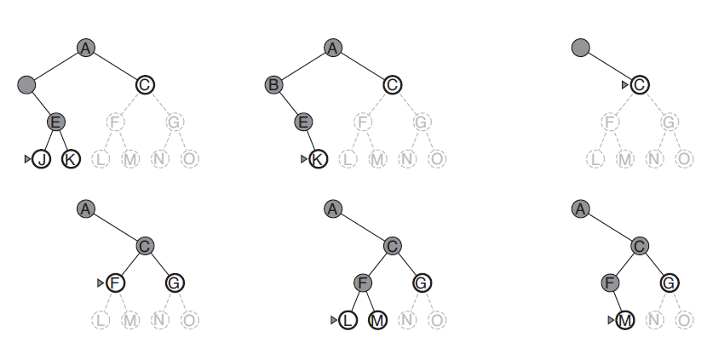
Depth-first search on a binary tree.

Slide 9
It always expands the deepest node in the current fringe of the search tree.
If dead end occurs, backtracking is done to the next immediate previous node for nodes to be expanded.
Advantage: If more than one solution exists (or) number of levels is high then DFS is best because exploration is done only in a small portion of the whole space.
Disadvantage: Not guaranteed to find a solution.

Slide 10
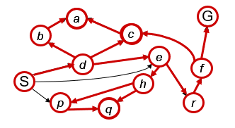
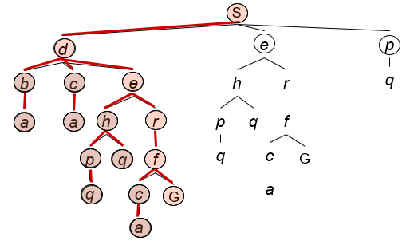
Strategy: expand a deepest node first
Implementation: Fringe is a LIFO stack

Slide 11
Given the following state space (tree search), give the sequence of visited nodes when using DFS (assume that the node O is the goal state):
A
B
C
D
E
F
G
H
I
J
K
L
M
N
O

Slide 12
A
A
B
C
D
E

Slide 13
A, B
A
B
C
D
E
F
G

Slide 14
A, B, F
A
B
C
D
E
F
G

Slide 15
A, B, F
G
A
B
C
D
E
F
G
K
L

Slide 16
A, B, F
G, K
A
B
C
D
E
F
G
K
L

Slide 17
A, B, F
G, K
L
A
B
C
D
E
F
G
K
L
O

Slide 18
A, B, F
G, K
L, O: Goal State
A
B
C
D
E
F
G
K
L
O

Slide 19
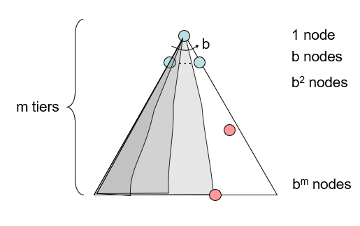
Depth-First Search (DFS) Properties
What nodes DFS expand?
  Some left prefix of the tree.
  Could process the whole tree!
  If m is finite, takes time O(b^{m})
How much space does the fringe take?
  Only has siblings on path to root,
  so O(b^{m})
Is it complete?
  m could be infinite, so only if we prevent cycles (more later)
Is it optimal?
  No, it finds the “leftmost” solution, regardless of depth or cost

Slide 20
For more courses visit
https://chandrashaker.com/courses
SUBSCRIBE

