Slide 1

Breadth-first search
A. Chandra Shaker

Slide 2
Uninformed Search Strategies
  Depth-first search
  Breadth-first search
  Uniform-cost search

Slide 3
  Breadth-first search

Slide 4
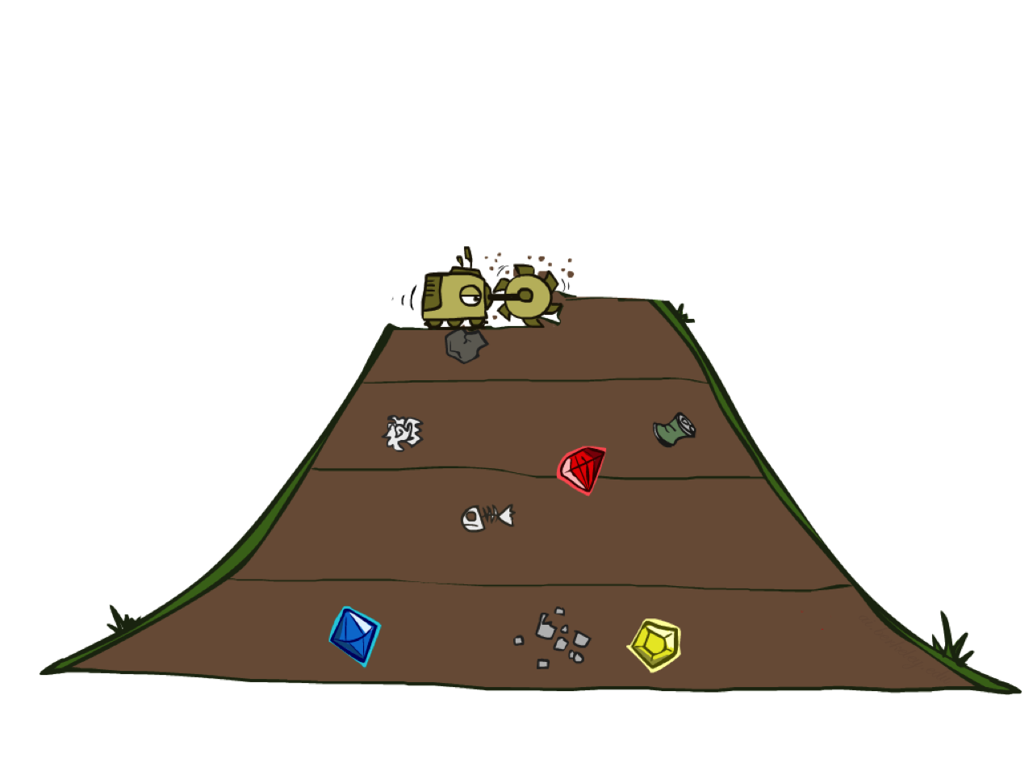
  Breadth-first search

Slide 5
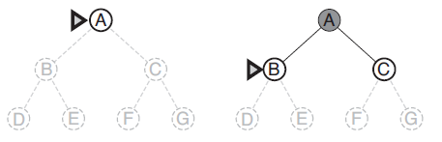
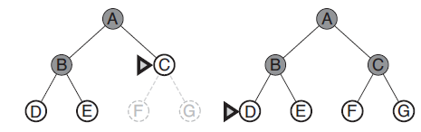
Breadth-first search on a simple binary tree.
At each stage, the node to be expanded next is indicated by a marker.

Slide 6
Breadth-first search is a simple strategy in which the root node is expanded first, then all the successors of the root node are expanded next, then their successors, and so on.
In general, all the nodes are expanded at a given depth in the search tree before any nodes at the next level are expanded.
Breadth-first search is an instance of the general graph-search algorithm in which the shallowest unexpanded node is chosen for expansion. This is achieved very simply by using a FIFO queue for the frontier.

Slide 7
Time complexity, the total number of nodes generated is b + b2 + b3 +…. +b^{d} = O (b^{d} ).
Every node that is generated must remain in memory
The space complexity is same as the time complexity.
Advantage: Guaranteed to find the single solution at the shallowest depth level.
Disadvantages:
  The memory requirements are a bigger problem for breadth-first search than is the execution time.
  Exponential-complexity search problems cannot be solved by uninformed methods for any but only suitable for smallest instances problem (i.e.) (number of levels to be minimum (or) branching factor to be minimum).

Slide 8
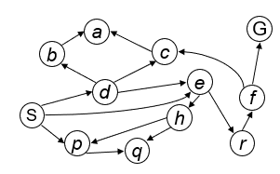
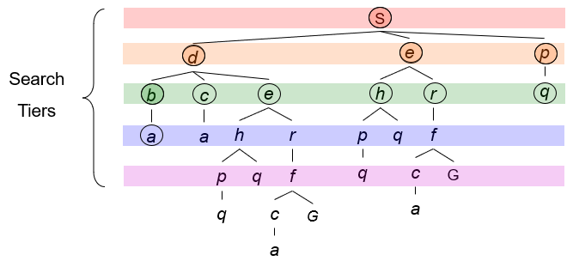
Strategy: expand a shallowest node first
Implementation: Fringe is a FIFO queue

Slide 9
Given the following state space (tree search), give the sequence of visited nodes when using BFS (assume that the node O is the goal state):
A
B
C
D
E
F
G
H
I
J
K
L
M
N
O

Slide 10
A
A
B
C
D
E

Slide 11
A
B
A
B
C
D
E
F
G

Slide 12
A
B, C
A
B
C
D
E
F
G
H

Slide 13
A
B, C, D
A
B
C
D
E
F
G
H
I
J

Slide 14
A
B, C, D, E
A
B
C
D
E
F
G
H
I
J

Slide 15
A
B, C, D, E
F
A
B
C
D
E
F
G
H
I
J

Slide 16
A
B, C, D, E
F, G
A
B
C
D
E
F
G
H
I
J
K
L

Slide 17
A
B, C, D, E
F, G, H
A
B
C
D
E
F
G
H
I
J
K
L

Slide 18
A
B, C, D, E
F, G, H, I
A
B
C
D
E
F
G
H
I
J
K
L
M

Slide 19
A
B, C, D, E
F, G, H, I, J
A
B
C
D
E
F
G
H
I
J
K
L
M
N

Slide 20
A
B, C, D, E
F, G, H, I, J
K
A
B
C
D
E
F
G
H
I
J
K
L
M
N

Slide 21
A
B, C, D, E
F, G, H, I, J
K, L
A
B
C
D
E
F
G
H
I
J
K
L
M
N
O

Slide 22
A
B, C, D, E
F, G, H, I, J
K, L, M
A
B
C
D
E
F
G
H
I
J
K
L
M
N
O

Slide 23
A
B, C, D, E
F, G, H, I, J
K, L, M, N
A
B
C
D
E
F
G
H
I
J
K
L
M
N
O

Slide 24
A
B, C, D, E
F, G, H, I, J
K, L, M, N
Goal State: O
A
B
C
D
E
F
G
H
I
J
K
L
M
N
O

Slide 25
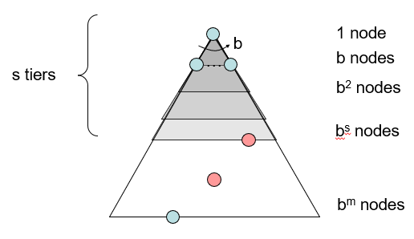
Breadth-First Search (BFS) Properties
What nodes does BFS expand?
  Processes all nodes above shallowest solution
  Let depth of shallowest solution be s
  Search takes time O(b^{s})
How much space does the fringe take?
  Has roughly the last tier, so O(b^{s})
Is it complete?
  s must be finite if a solution exists, so yes!
Is it optimal?
  Only if costs are all 1 (more on costs later)

Slide 26

SUBSCRIBE
For more courses visit
https://chandrashaker.com/courses

