Slide 1
Hill Climbing Search
Source: https://web.cs.hacettepe.edu.tr/~ilyas/Courses/VBM688/lec05_localsearch.pdf

Slide 2
Local Search
The uninformed and informed search algorithms that we have seen are designed to explore search spaces systematically.
  They keep one or more paths in memory and by record which alternatives have been explored at each point along the path.
  When a goal is found, the path to that goal also constitutes a solution to the problem.
  In many problems, however, the path to the goal is irrelevant.
If the path to the goal does not matter, we might consider a different class of algorithms that do not
worry about paths at all.
➔ local search algorithms

Slide 3
Local Search
Local search algorithms operate using a single current node and generally move only to neighbors of that node.
Local search algorithms ease up on completeness and optimality in the interest of improving time
and space complexity?
Although local search algorithms are not systematic, they have two key advantages:
  They use very little memory (usually a constant amount), and
  They can often find reasonable solutions in large or infinite (continuous) state spaces.
In addition to finding goals, local search algorithms are useful for solving pure optimization problems, in which the aim is to find the best state according to an objective function.
In optimization problems, the path to goal is irrelevant and the goal state itself is the solution.
In some optimization problems, the goal is not known and the aim is to find the best state.

Slide 4
Hill Climbing Search
(Steepest Ascent/Descent)
At each iteration, the hill-climbing search algorithm moves to the best successor of the current node according to an objective function.
  Best successor is the successor with best value (highest or lowest) according to an objective function.
  If no successors have better value than the current value, it returns.
  It moves in direction of uphill (hill climbing).
  It terminates when it reaches a “peak” where no neighbor has a higher value.
The algorithm does not maintain a search tree, so the data structure for the current node need only record the state and the value of the objective function.
Hill climbing does not look ahead beyond the immediate neighbors of the current state.
Hill climbing is sometimes called greedy local search because it grabs a good neighbor state without thinking ahead about where to go next.
  Greedy algorithms often perform quite well and
  Hill climbing often makes rapid progress toward a solution.

Slide 5
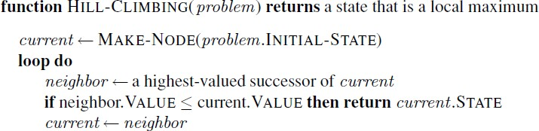
Hill Climbing Search
(Steepest Ascent/Descent)
best successor

Slide 6
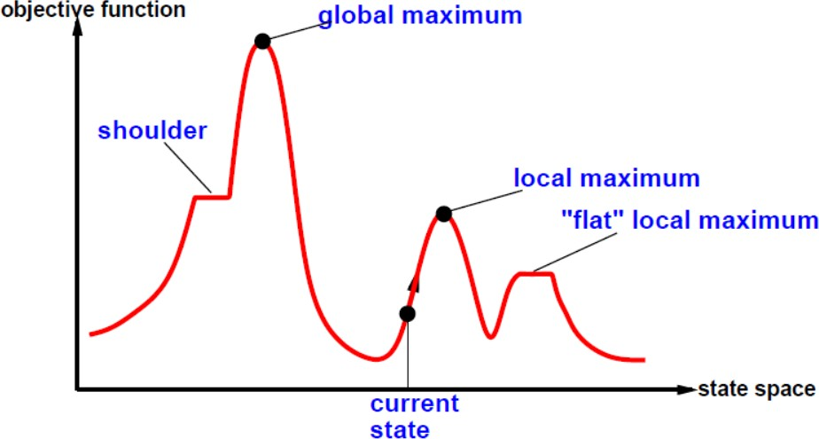
Hill Climbing Search
To understand local search, it is useful to consider the state-space landscape.
The aim is to find the highest peak - a global maximum.
Hill-climbing search modifies the current state to try to improve it.

Slide 7
Hill Climbing Search
A local maximum is a peak that is higher than each of its neighboring states but lower than the
global maximum.
  Hill-climbing algorithms that reach the vicinity of a local maximum will be drawn upward toward the peak but will then be stuck with nowhere else to go.
A plateau is a flat area of the state-space landscape. It can be a flat local maximum, from which no uphill exit exists, or a shoulder, from which progress is possible.
  A hill-climbing search might get lost on the plateau.
  Random sideways moves can escape from shoulders but they loop forever on flat maxima.

Slide 8
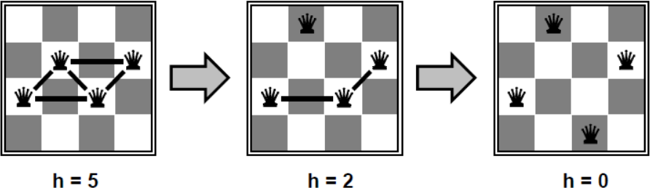
Hill Climbing Example
n-queens
Put n queens on an n × n board with no two queens on the same row, column, or diagonal
Move a queen to reduce number of conflicts.
➔ Objective function: number of conflicts (no conflicts is global minimum)
The successors of a state are all possible states generated by moving a single queen to another square in the same column (so each state has n*(n-1) successors).
The heuristic cost function h is the number of pairs of queens that are attacking each other, either directly or indirectly.
The global minimum of this function is zero, which occurs only at perfect solutions.

Slide 9
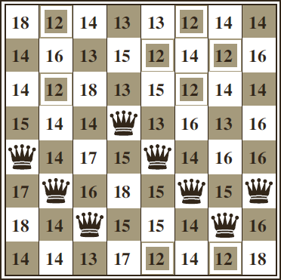
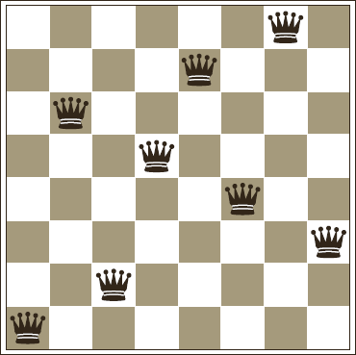
Hill Climbing Example
n-queens
Hill Climbing may NOT reach to a goal state for n-queens problem.
➔ five steps to reach this state
An 8-queens state with heuristic cost estimate h=17
The value of h for each possible successor obtained by moving a queen within its column.
The best moves are marked with value 12.
A local minimum in the 8-queens state space; the state has h=1
but every successor has a higher cost.
Hill Climbing will stuck here

Slide 10
Hill Climbing Example
n-queens
Starting from a randomly generated 8-queens state, steepest-ascent hill climbing gets stuck 86% of the time, solving only 14% of problem instances.
The Hill Climbing algorithm halts if it reaches a plateau.
  One possible solution is to allow sideways move in the hope that the plateau is really a shoulder.
  If we always allow sideways moves when there are no uphill moves, an infinite loop will occur whenever the algorithm reaches a flat local maximum that is not a shoulder.
  One common solution is to put a limit on the number of consecutive sideways moves allowed.
  For example, we could allow up to 100 consecutive sideways moves in the 8-queens problem. This raises the percentage of problem instances solved by hill climbing from 14% to 94%.

Slide 11
Hill Climbing Example
8-puzzle
Heuristic function is Manhattan Distance
1 | 4 | 2
 | 3 | 5
6 | 7 | 8
h = 3

Slide 12
Hill Climbing Example
8-puzzle
 | 4 | 2
1 | 3 | 5
6 | 7 | 8
Heuristic function is Manhattan Distance
h = 4
1 | 4 | 2
 | 3 | 5
6 | 7 | 8
1 | 4 | 2
3 |  | 5
6 | 7 | 8
h = 3
h = 2
1 | 4 | 2
6 | 3 | 5
 | 7 | 8
h = 4

Slide 13
Hill Climbing Example
8-puzzle
 | 4 | 2
1 | 3 | 5
6 | 7 | 8
1 | 4 | 2
 | 3 | 5
6 | 7 | 8
Heuristic function is Manhattan Distance
h = 4
h = 3
1 |  | 2
3 | 4 | 5
6 | 7 | 8
1 | 4 | 2
 | 3 | 5
6 | 7 | 8
1 | 4 | 2
3 |  | 5
6 | 7 | 8
h = 1
h = 2
1 | 4 | 2
3 | 5
6 | 7 | 8
h = 3
1 | 4 | 2
6 | 3 | 5
 | 7 | 8
h = 3
1 | 4 | 2
3 | 7 | 5
6 |  | 8
h = 4
h = 3

Slide 14
Hill Climbing Example
8-puzzle: a solution case
 | 4 | 2
1 | 3 | 5
6 | 7 | 8
1 | 4 | 2
 | 3 | 5
6 | 7 | 8
Heuristic function is Manhattan Distance
h = 4
h = 3
1 |  | 2
3 | 4 | 5
6 | 7 | 8
1 |  | 2
3 | 4 | 5
6 | 7 | 8
1 | 4 | 2
 | 3 | 5
6 | 7 | 8
1 | 4 | 2
3 |  | 5
6 | 7 | 8
h = 1
h = 0
h = 2
1 | 4 | 2
3 | 5
6 | 7 | 8
h = 3
1 | 4 | 2
6 | 3 | 5
 | 7 | 8
h = 3
1 | 4 | 2
3 | 7 | 5
6 |  | 8
h = 4
h = 3

Slide 15
Hill Climbing Example
8-puzzle: stuck at local maximum
2 |  | 3
1 | 8 | 4
7 | 6 | 5
1 | 2 | 3
7 | 8 | 4
 | 6 | 5
Heuristic function is Manhattan Distance
h = 13
h = 12
 | 2 | 3
1 | 8 | 4
7 | 6 | 5
1 | 2 | 3
 | 8 | 4
7 | 6 | 5
 | 2 | 3
1 | 8 | 4
7 | 6 | 5
We are stuck with a local maximum.
h = 12
h = 11
h = 12
1 | 2 | 3
8 |  | 4
7 | 6 | 5
h = 12

Slide 16
Hill Climbing
Hill Climbing is NOT complete.
Hill Climbing is NOT optimal.
Why use local search?
  Low memory requirements – usually constant
  Effective – Can often find good solutions in extremely large state spaces
  Randomized variants of hill climbing can solve many of the drawbacks in practice.
Many variants of hill climbing have been invented.

Slide 17
Stochastic Hill Climbing
Stochastic hill climbing chooses at random from among the uphill moves;
The probability of selection can vary with the steepness of the uphill move.
Stochastic hill climbing usually converges more slowly than steepest ascent, but in some state
landscapes, it finds better solutions.
Stochastic hill climbing is NOT complete, but it may be less likely to get stuck.

Slide 18
First-Choice Hill Climbing
First-choice hill climbing implements stochastic hill climbing by generating successors randomly until one is generated that is better than the current state.
This is a good strategy when a state has many of successors.
First-choice hill climbing is also NOT complete,

Slide 19
Random-Restart Hill Climbing
Random-Restart Hill Climbing conducts a series of hill-climbing searches from randomly generated initial states, until a goal is found.
Random-Restart Hill Climbing is complete if infinite (or sufficiently many tries) are allowed.
If each hill-climbing search has a probability p of success, then the expected number of restarts required is 1/p.
For 8-queens instances with no sideways moves allowed, p ≈ 0.14, so we need roughly 7 iterations to find a goal (6 failures and 1 success).
  For 8-queens, then, random-restart hill climbing is very effective indeed.
  Even for three million queens, the approach can find solutions in under a minute.
The success of hill climbing depends very much on the shape of the state-space landscape:
  If there are few local maxima and plateau, random-restart hill climbing will find a good solution very quickly.
  On the other hand, many real problems have many local maxima to get stuck on.
  NP-hard problems typically have an exponential number of local maxima to get stuck on.

