Slide 1
Unit 5 Ch 1
Logic Families

Slide 2
Logic Families
Logic Families : It is a collection of different IC chips that have similar input, output and internal circuit characteristics i.e. group of compatible ICs with same logic levels and supply voltages but perform different logic functions.
Various digital functions are being fabricated in a variety of forms using Bipolar and Unipolar technologies.
NOTE:
1) Chips from same family can be interconnected.
2) Chips from different family may not be compatible, means they may use different power supply voltages and input, output conditions.

Slide 3
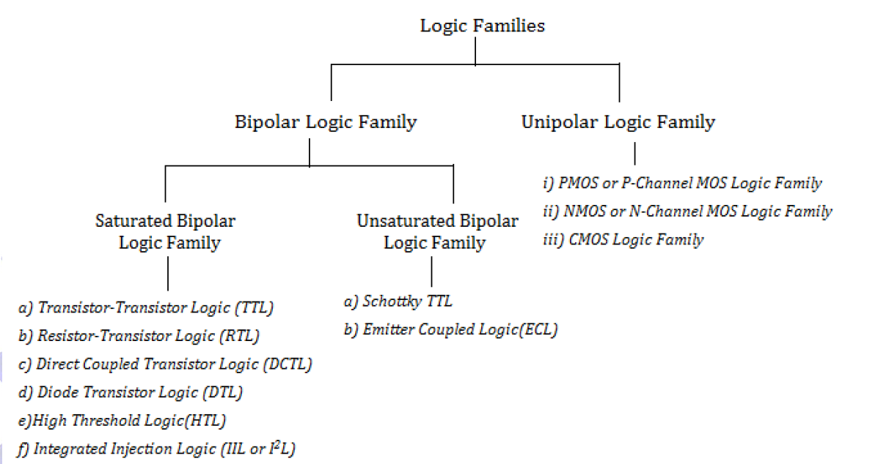
Classification of logic families

Slide 4
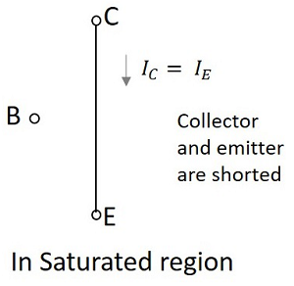
Saturation region:
This is the region in which transistor tends to behave as a closed switch. The transistor has the effect of its collector and Emitter being shorted. The collector and Emitter currents are maximum in this mode of operation.

Slide 5
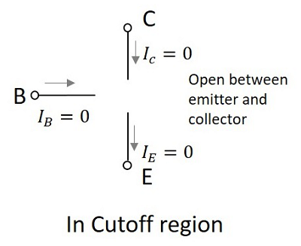
Cutoff region:
This is the region in which transistor tends to behave as an open switch. The transistor has the effect of its collector and base being opened. The collector, emitter and base currents are all zero in this mode of operation.

Slide 6
Classification of Digital ICs
We are all familiar with terms like SSI, MSI, LSI, VLSI and ULSI being used with reference to digital integrated circuits.
These terms refer to groups in which digital ICs are divided on the basis of the complexity of the circuitry integrated on the chip.
SSI, MSI, LSI, VLSI, ULSI

Slide 7
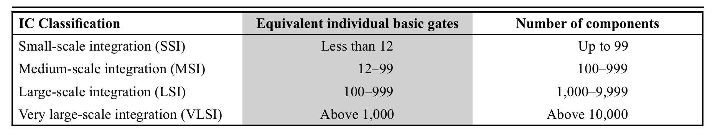

Slide 8
A small-scale integration (SSI) chip is one that contains circuitry equivalent in complexity to less than 12 logic gates, (up to 99 components). This category of digital ICs includes basic logic gates and flip-flops.
A medium-scale integration (MSI) chip is one that contains circuitry equivalent in complexity to 12–99 gates, (100 to 999 components). This category of digital ICs includes multiplexers, demultiplexers, counters, registers, small memories, arithmetic circuits and others.
A large-scale integration (LSI) chip is one that contains circuitry equivalent in complexity to 100–999 gates, (1000 to 9999 components). Includes memories.

Slide 9
A very-large-scale integration (VLSI) chip contains circuitry equivalent in complexity to 1000 – 9999 gates, (10000 to 99999 components). Large-sized memories and microprocessors come in the category of LSI and VLSI chips.
An ultra large-scale integration (ULSI) chip contains circuitry equivalent in complexity to more than 10000 or more gates, (100000 and above components). Very large memories, larger microprocessors and larger single-chip computers come into this category.

Slide 10
Characteristics of digital IC’s:
1. Fan in: Fan in is the maximum number of inputs connected to the gate without any degradation in the voltage level.
2. Fan-out : Fan out specifies the number of standard loads that the output of the gate can drive without impairment of its normal operation.
Or the number of similar gates which can be driven by a gate. High Fanout is advantageous. Fanout is more for CMOS than TTL.
3. Power dissipation: Power dissipation is measure of power consumed by the gate when fully driven by all its inputs. Minimum for CMOS and maximum for ECL.

Slide 11
4. Propagation delay : it is the average transition delay time for the signal to propagate from input to output when the signals change in value, expressed in ns.
5. Speed of operation: Determined by the time between the application of input and change in output. specified in terms of propagation delay time.
6. Noise Immunity: The amount of noise voltages that the given gate is able to withstand without effecting its normal operation. A quantitative measure is called noise margin.
7. Noise margin : It is the maximum noise voltage added to an input signal of a digital circuit that does not cause an undesirable change in the output. (two types: dc noise margins, ac noise margins – provided by manufacturers)

Slide 12
8. Voltage Parameters: V_{IH}, V_{IL}, V_{OH}, V_{OL}
Current Parameters: I_{IH}, I_{IL}, I_{OH}, I_{OL}
9. Operating temperature: The temperature range in which an IC functions properly must be known. Accepted temperature ranges are: 0 to +70 ºC for consumer and industrial applications and -55 ºC to +125 ºC for military purposes.
10. Power supply requirements: The supply voltages and the amount of power required by an IC are important characteristics.

Slide 13
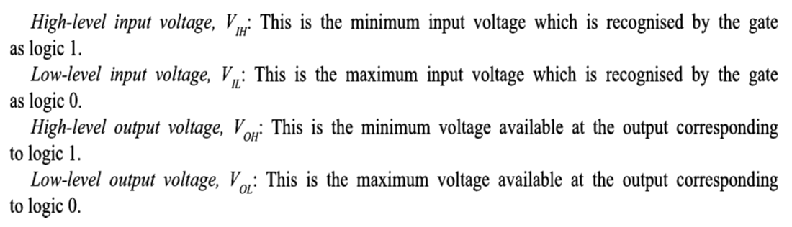

Slide 14
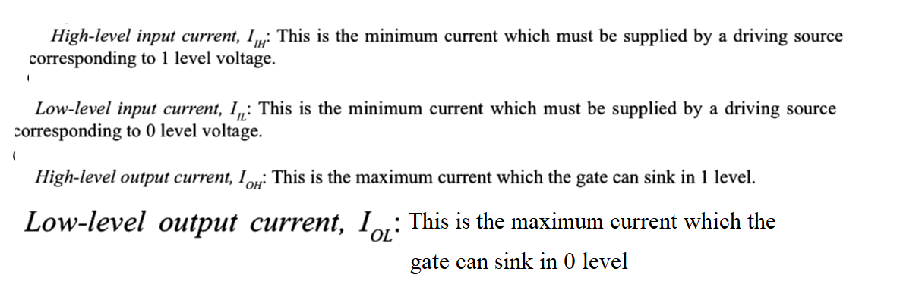

Slide 15
Characteristics of Logic families
Speed
Fan-in
Fan-out
Power Dissipation
Noise Immunity and Noise Margin
Speed power product or Figure of merit: It is the product of propagation delay and power dissipation.
Logic swing: The difference in output values high to low is called logic swing.
Breadth of logic family: Number of different logic functions available in that logic family.

Slide 16
The most widely used families are:
Transistor-transistor logic (TTL)
Emitter-coupled logic (ECL)
MOS Logic, CMOS Logic

Slide 17
Logic families: Comparison

Slide 18
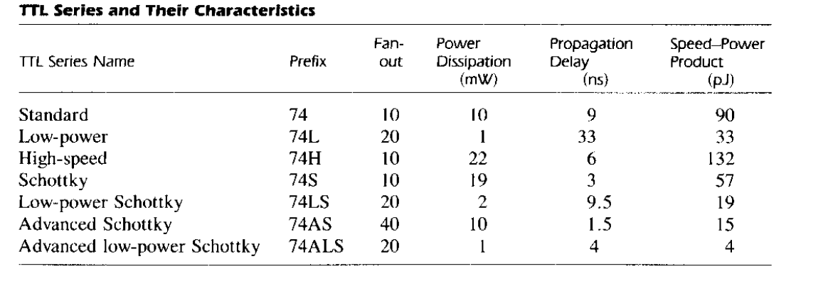

Slide 19
Transistor–transistor logic (TTL)
Transistor–transistor logic (TTL) is a logic family built from bipolar junction transistors. Its name signifies that transistors perform both the logic function (the first "transistor") and the amplifying function (the second "transistor");
TTL integrated circuits (ICs) were widely used in applications such as computers, industrial controls, test equipment and instrumentation, consumer electronics, and synthesizers.

Slide 20
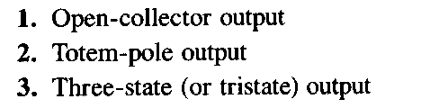
TTL available in three different output configurations

Slide 21
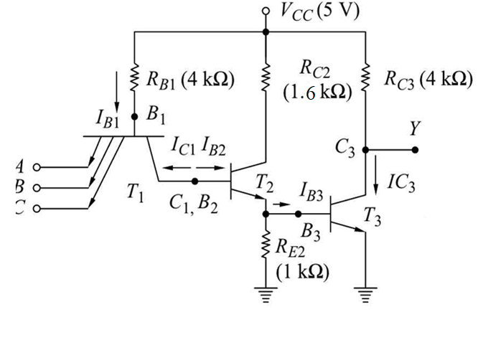
3 –input TTL NAND gate

Slide 22
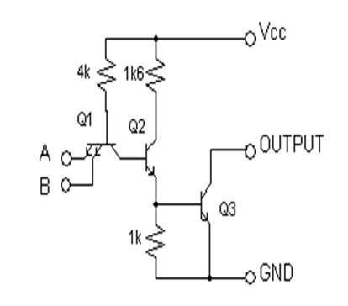

Slide 23
Totem Pole Output:
Totem Pole means addition of an active pull up circuit in the output of the Gate which results in reduction of propagation delay.
Logic operation is same as the open collector output. Use of transistors Q4 and diode is to provide quick charging and discharging of parasitic capacitance across Q3.

Slide 24
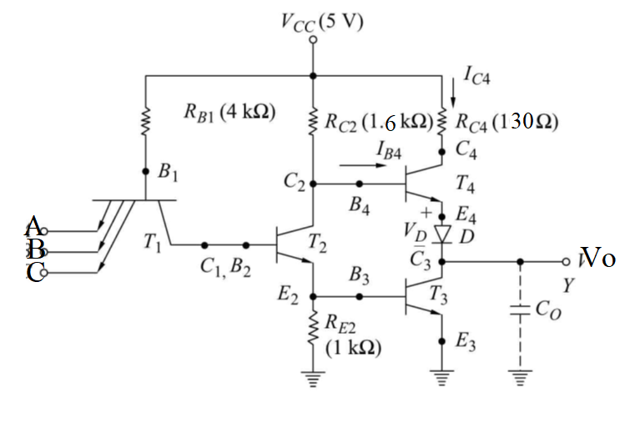

Slide 25
Three state(Tristate) output
Totem-pole output TTL gate has 3-state gate property
A Three-state gate exhibits 3 outputs:
(1) a low-level state
(2) a high level state
(3) high impedance, open circuit or output is floating
( both T3 and T4 transistors are off)

Slide 26
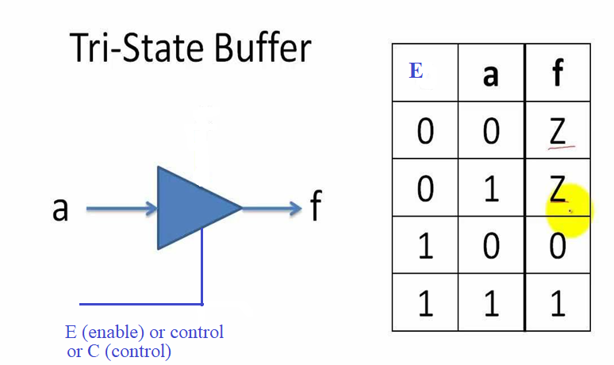

Slide 27
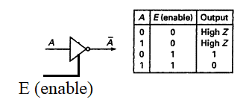
Three-state inverter gate

Slide 28
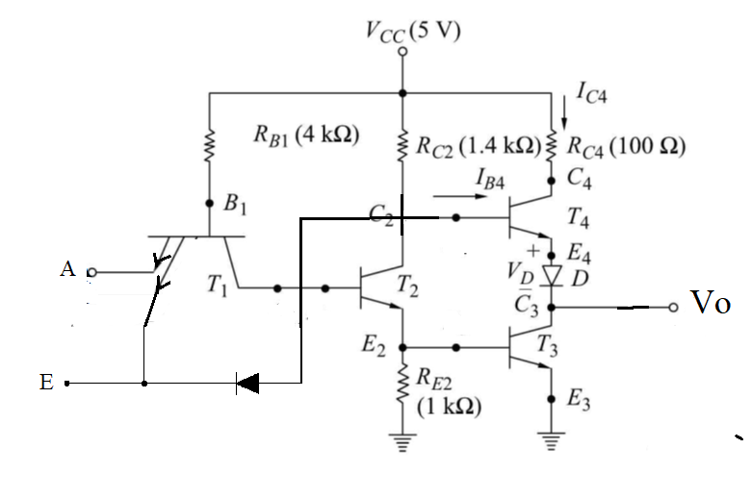

Slide 29
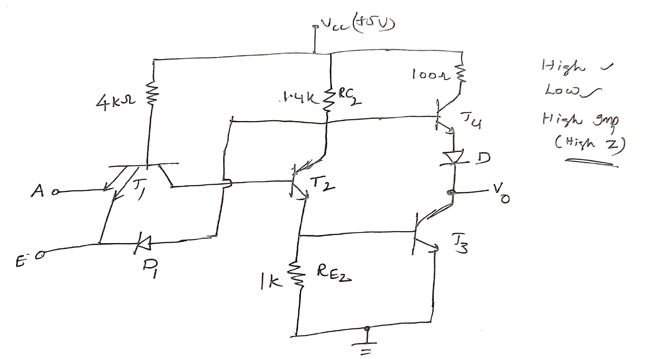

Slide 30
Types of TTL
Standard TTL
Low-power TTL (L)
High-speed TTL (H)
Schottky TTL (S)
Low-power Schottky TTL (LS)

Slide 31
Emitter-coupled logic (ECL)
Based on bipolar transistors, but removes problems of storage time by preventing the transistors from saturating. (operates in active and cutoff)
-0.8V for high, -1.8V for low (works with negative voltages) also called current mode logic.
Very fast operation - propagation delays of 1ns or less
High power consumption, perhaps 60 mW/gate
Low noise immunity of about 0.2-0.25 V
Used in some high speed specialist applications, but now largely replaced by high speed CMOS

Slide 32
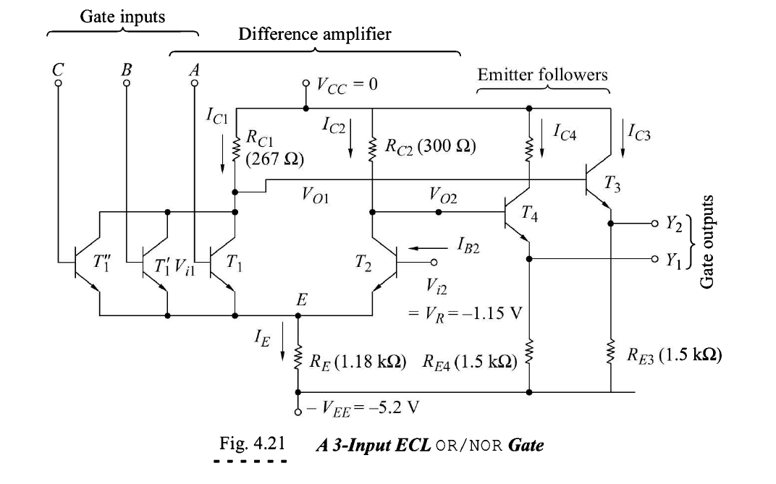
3-input ECL OR/NOR Gate

Slide 33
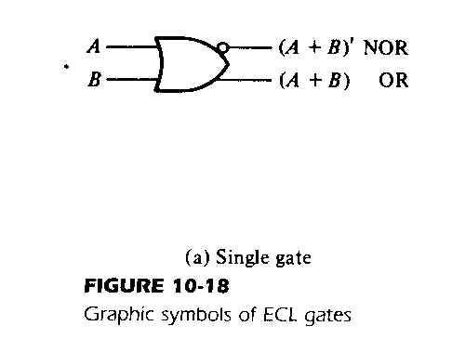
ECL Logic

Slide 34
MOS Logic
MOS logic family implements the logic gates using MOSFET devices.
MOSFETs are high density devices which can easily and economically fabricated on ICs.
MOS logic gates can be fabricated using either only NMOS or only PMOS devices.
One advantage of the MOS device is that it can be used not only as a transistor, but as a resistor as well. A resistor is obtained from the MOS by permanently biasing the gate terminal for conduction.

Slide 35
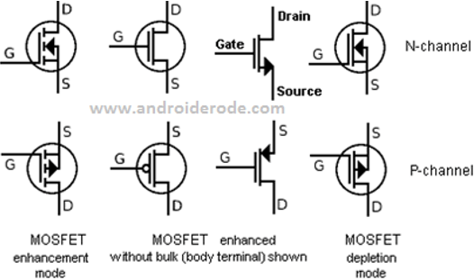

Slide 36
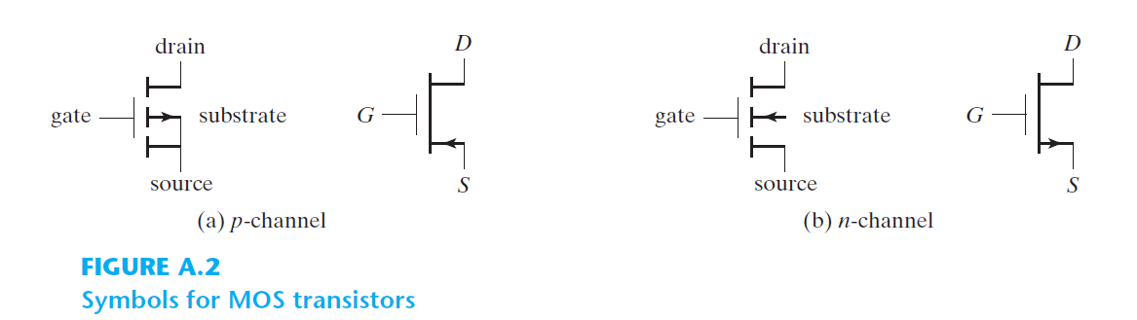

Slide 37
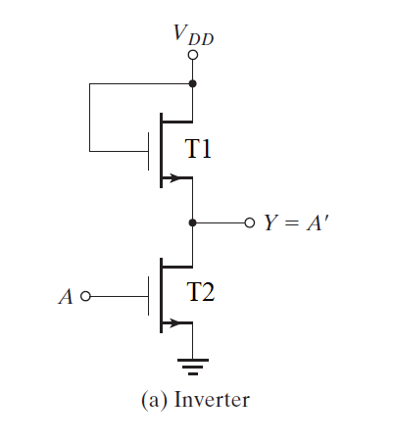
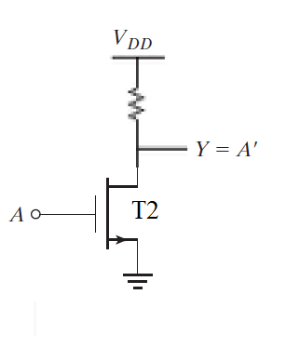
NMOS Inverter gate

Slide 38
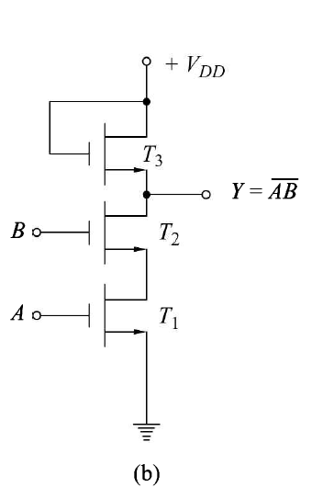
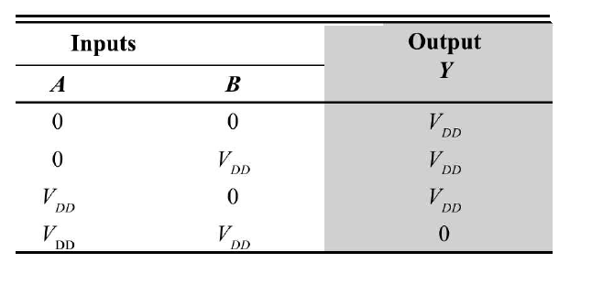
2-input NMOS NAND gate

Slide 39
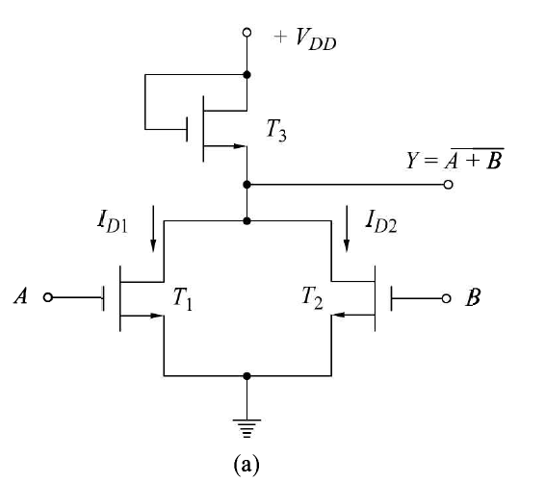
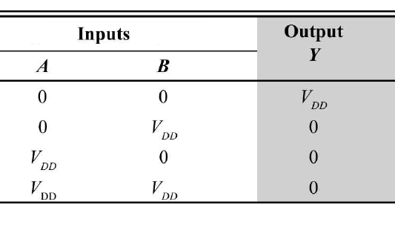
2-input NMOS NOR gate

Slide 40
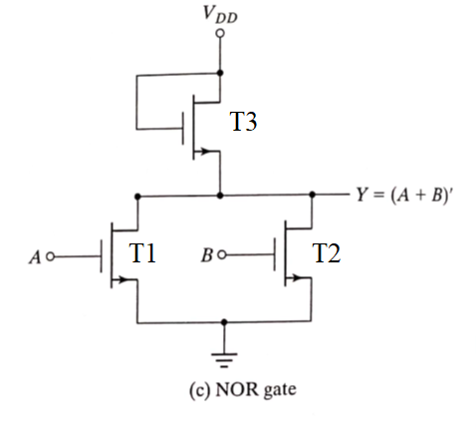
2-input NMOS NOR gate

Slide 41
Advantages and Disadvantages of MOS inverter
  Advantages: only a single type of transistor, So, it can be fabricated at low cost.
  Disadvantages: as current flows through the resistor in one of the two states, more power consumption is there processing speed is slow

Slide 42
CMOS Logic: CMOS stands for complementary-MOS, in which both p-channel and n-channel enhancement MOSFET devices are fabricated on same chip.
CMOS devices consume negligible power and hence are preferred over MOS devices.
The n ‐channel MOS conducts when its gate‐to‐source voltage is positive.
The p ‐channel MOS conducts when its gate‐to‐source voltage is negative.
Either type of device is turned off if its gate‐to‐source voltage is zero.

Slide 43
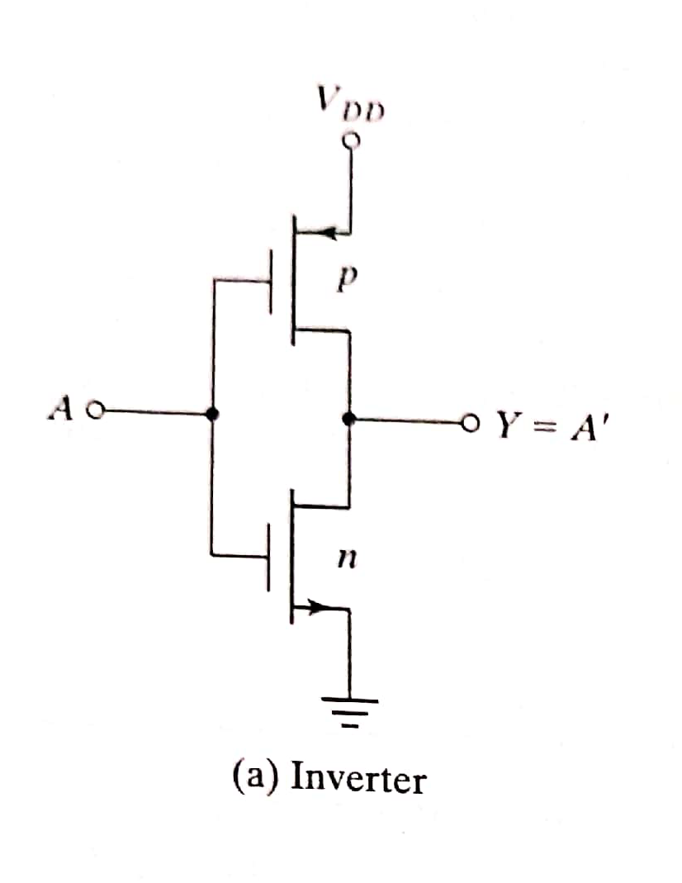
CMOS inverter

Slide 44
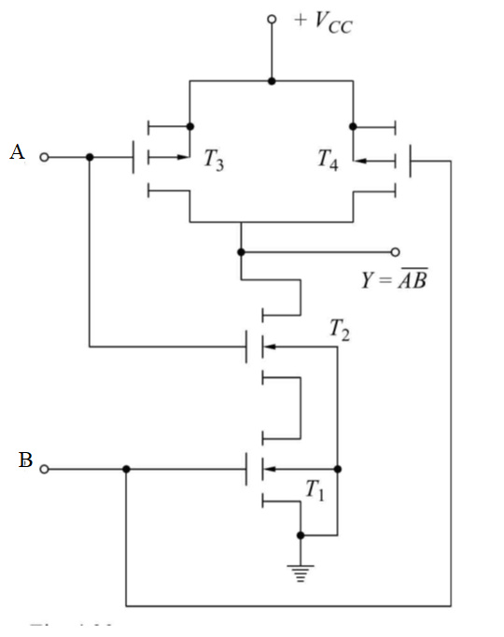
2-inputCMOS NAND gate

Slide 45
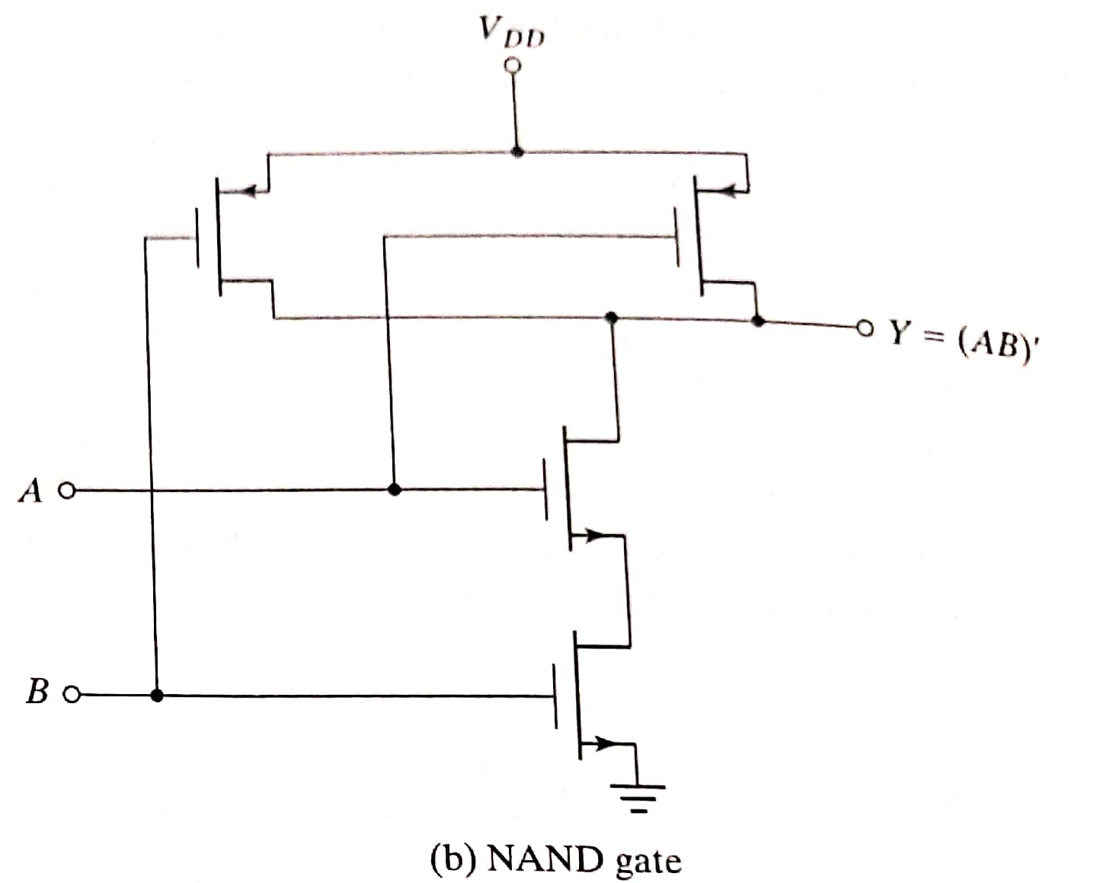
2-inputCMOS NAND gate

Slide 46
CMOS NAND Operation

Slide 47
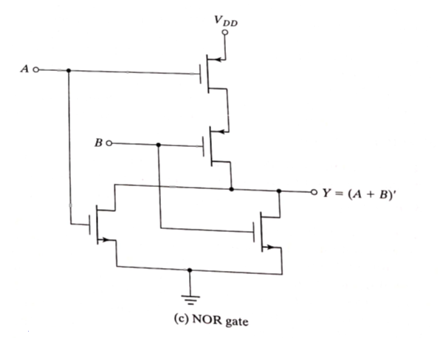
2-inputCMOS NOR gate

Slide 48
CMOS Buffer

Slide 49
CMOS AND and OR Gates

Slide 50
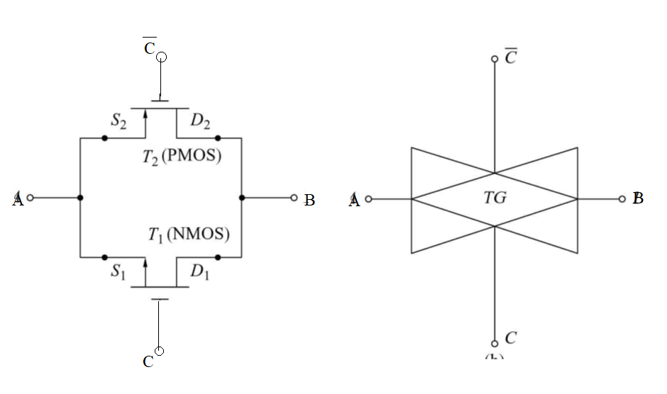

Slide 51
Connecting PMOS and NMOS devices together in parallel we can create a basic bilateral CMOS switch, known commonly as a “Transmission Gate”.
This bilateral operation is shown in the transmission gate symbol below which shows two superimposed triangles pointing in opposite directions to indicate the two signal directions.

Slide 52
A transmission gate (TG) is an analog gate similar to a relay that can conduct in both directions or block by a control signal with almost any voltage potential.
When the control input is a logic zero he gate-source voltage of the n-channel MOSFETs is always negative, and the p-channel MOSFETs is always positive. Accordingly, neither of the two transistors will conduct and the transmission gate turns off.
When the control input is a logic one, the gate terminal of the n-channel MOSFETs is located at a positive supply voltage potential. By the inverter, the gate terminal of the p-channel MOSFETs is now at a negative supply voltage potential. One of the transistor will conduct and the signal reaches to B. and vice versa.

Slide 53
IC interfacing
Connecting the output(s) of one circuit to the input(s) of another circuit that has different electrical characteristics.
Occurs often in complex digital systems, where designers utilize different logic families for different parts of system.
Interfacing ECL and TTL
Interfacing CMOS and TTL
Interfacing CMOS and ECL

Slide 54
IC Interfacing
When interfacing logic families, several considerations must be made.
The output voltage level of one family must be high and low enough to meet the input requirements of the receiving family.
Also, the output current capability of the driving gate must be high enough for the input draw of the receiving gate or gates.

Slide 55
1. CMOS driving TTL: CMOS gate driving N number of TTL gates, the following conditions are required to be satisfied.
V_{OH} (CMOS) ≥ V_{IH}(TTL)
V_{OL} (CMOS) ≤ V_{IL}(TTL)
– I_{OH} (CMOS) ≥ NI_{IH}(TTL)
I_{OL} (CMOS) ≥ – NI_{IL}(TTL)

Slide 56
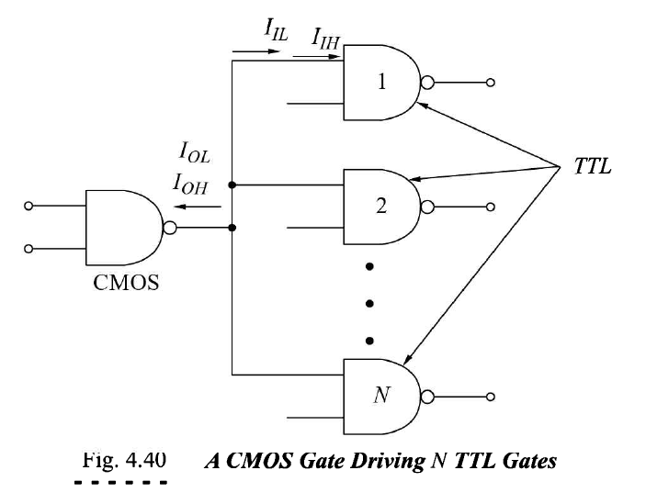

Slide 58
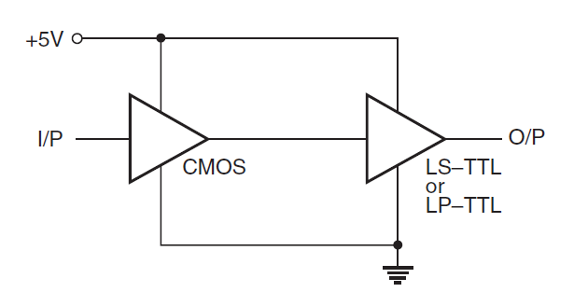
1. CMOS to TTL Interface: The figure shows a CMOS-to-TTL interface with both devices operating from 5V supply and the CMOS IC driving a low-power TTL or a low-power Schottky TTL device.

Slide 59
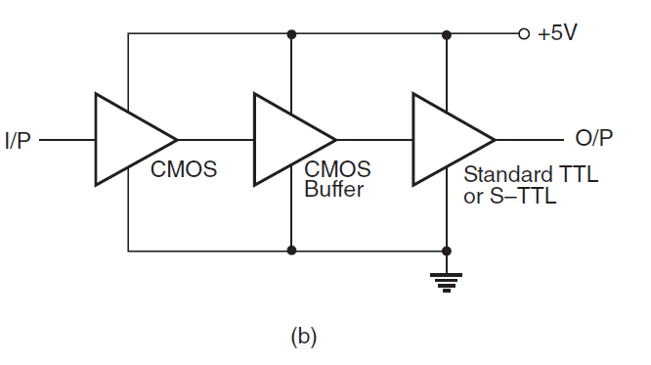
2. CMOS-to-TTL interface: The TTL device in use is either a standard TTL or a Schottky TTL

Slide 60
TTL Driving CMOS :
V_{OH} (TTL) ≥ V_{IH}(CMOS)
V_{OL} (TTL) ≤ V_{IL}(CMOS)
– I_{OH} (TTL) ≥ NI_{IH}(CMOS)
I_{OL} (TTL) ≥ – NI_{IL}(CMOS)

Slide 61
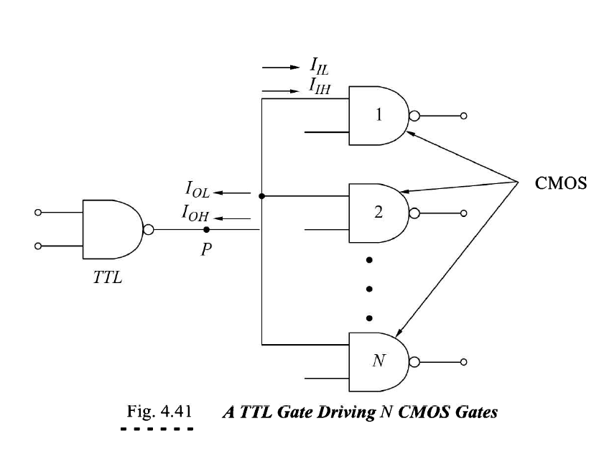

Slide 62
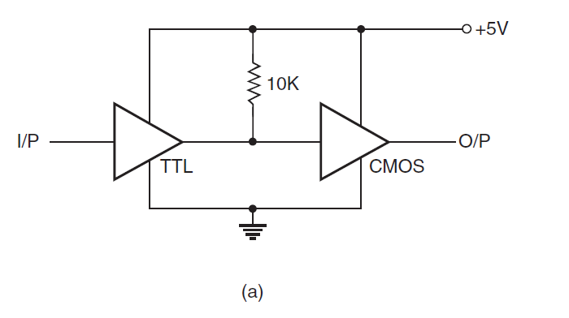
1. When the two devices are operating on the same power supply voltage, that is, 5 V, a pull-up resistor of 10 k achieves compatibility.
The pull-up resistor causes the TTL output to rise to about 5V when HIGH.

Slide 63
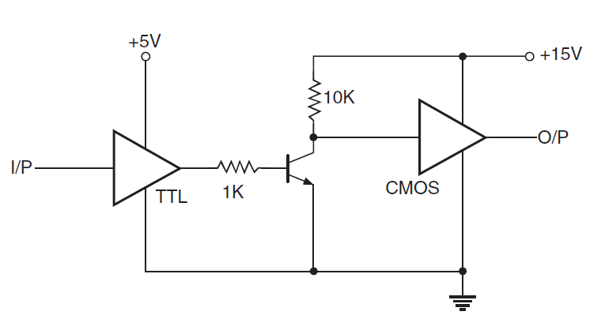
2. When the two are operating on different power supplies, one of the simplest interface techniques is to use a transistor (as a switch) in-between the two.

Slide 64
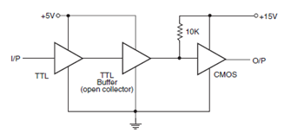
Another technique is to use an open collector type TTL buffer as shown in figure

Slide 65
Interfacing ECL and TTL Gates
It is often necessary to interconnect logic circuits of different families.
The interfacing between TTL and ECL gate is done with level shifting circuits. (level translators)
Because the logic levels in the two systems are entirely different.

Slide 66
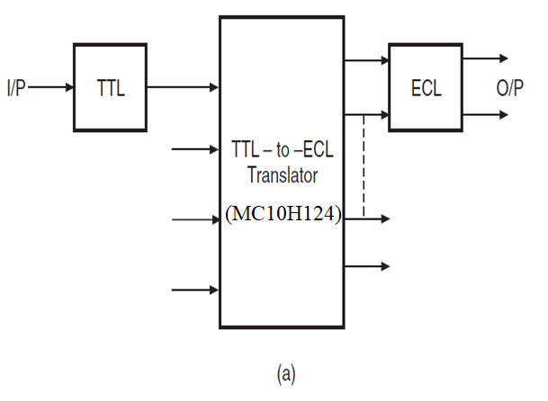
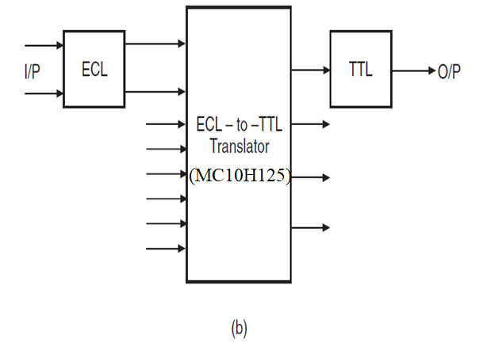
Figure: TTL-to-ECL and ECL-to-TTL interfaces

Slide 68
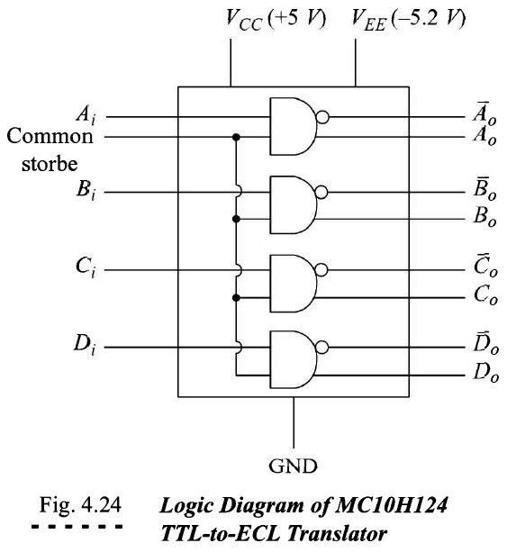
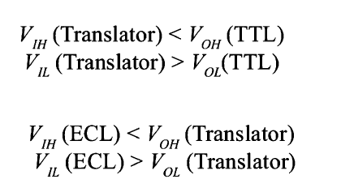

Slide 69
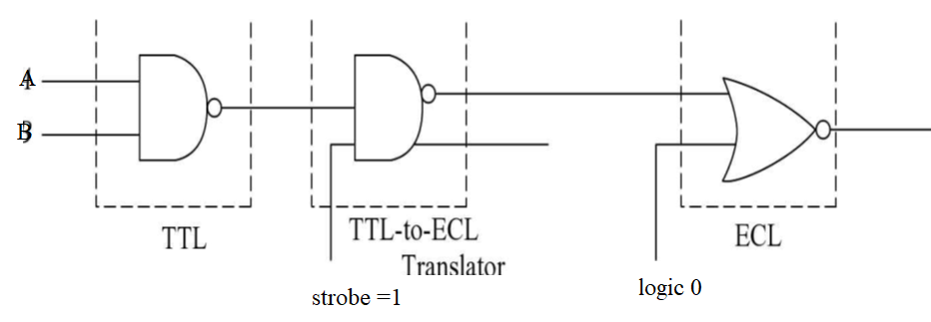

Slide 71
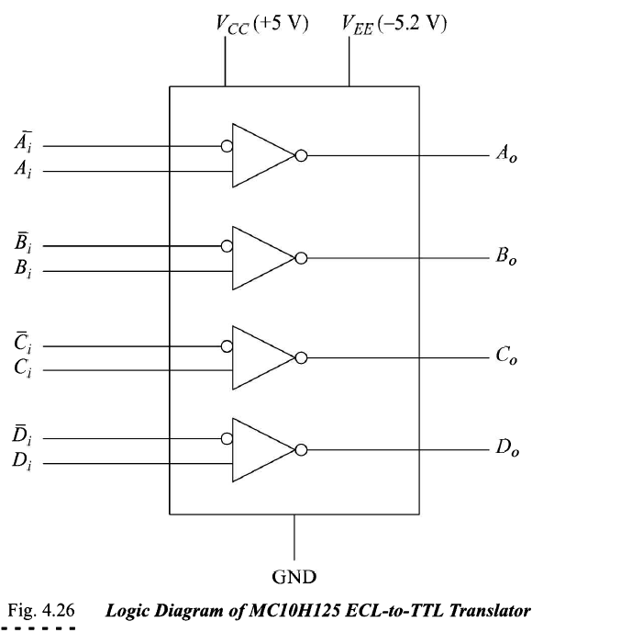

Slide 72
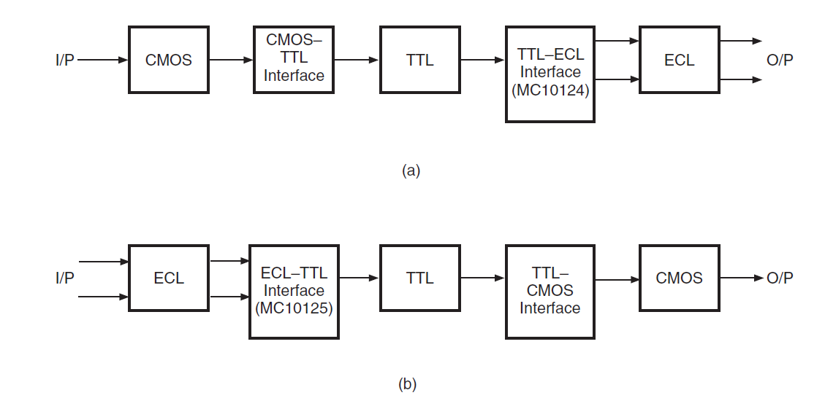
Figure: a) CMOS-to-ECL and b) ECL-to-CMOS interfaces
CMOS-to-ECL and ECL-to-CMOS Interfaces

