Slide 1
Fundamentals of Blockchain Technology
Module 3
Ethereum Blockchain
A. Chandra Shaker
Assistant Professor

Slide 2
Fundamentals of Blockchain Technology
Module 3:
Ethereum Blockchain
Ethereum Structure
Operations
Consensus Model
Incentive Model
Smart Contracts

Slide 3
Fundamentals of Blockchain Technology
Ethereum Blockchain: Understanding Its Structure

Slide 4
Fundamentals of Blockchain Technology
What is Ethereum?
A decentralized blockchain platform
Enables the creation of smart contracts and decentralized applications (DApps)
Has its own cryptocurrency, Ether (ETH)
Uses a virtual machine, the Ethereum Virtual Machine (EVM), to execute smart contracts
Allows for the creation of new tokens and cryptocurrencies through smart contracts

Slide 5
Fundamentals of Blockchain Technology
The Ethereum Virtual Machine (EVM)
A runtime environment for smart contracts in Ethereum
Executes code written in the Solidity programming language
Is a stack-based architecture
Operates on a gas-based system for transaction fees
Runs on every Ethereum node and enforces consensus rules

Slide 6
Fundamentals of Blockchain Technology
Smart Contracts
Self-executing contracts with the terms of the agreement between buyer and seller being directly written into lines of code
Run on blockchain technology and are stored on a decentralized network
Enable the creation of decentralized applications (DApps)
Can automate tasks and processes, reducing the need for intermediaries
Can interact with other smart contracts and cryptocurrencies, including Ether (ETH)

Slide 7
Fundamentals of Blockchain Technology
Decentralized Applications (DApps)
Applications built on blockchain technology that are decentralized and run on a network of computers instead of a central server
Use smart contracts to automate tasks and processes
Enable peer-to-peer transactions without intermediaries
Offer greater security and transparency than centralized applications
Examples include decentralized finance (DeFi) applications, gaming platforms, and social media networks

Slide 8
Fundamentals of Blockchain Technology
Ether Cryptocurrency (ETH)
The native cryptocurrency of the Ethereum blockchain
Used to pay for transaction fees and computational services on the network
Can be traded on cryptocurrency exchanges
Has a finite supply, with a maximum limit of 18 million ETH per year
Has a market capitalization that is second only to Bitcoin

Slide 9
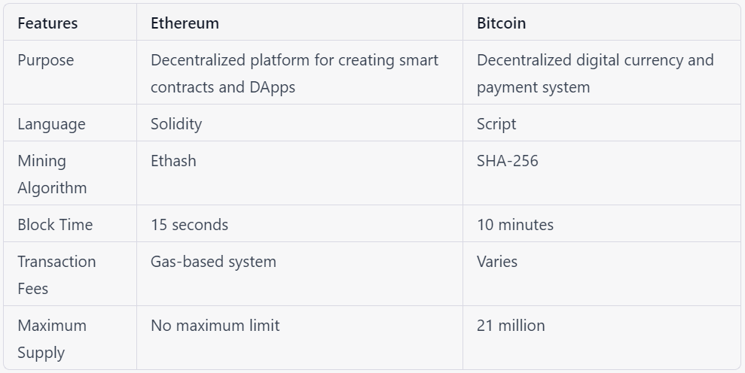
Fundamentals of Blockchain Technology
Comparison of Ethereum and Bitcoin Blockchain Structures

