Slide 1
Fundamentals of Blockchain Technology
Module 2
Bitcoin Technology Stack
A. Chandra Shaker
Assistant Professor

Slide 2
Fundamentals of Blockchain Technology
Module 2:
Bitcoin Technology Stack
Blockchain
Protocol
Currency
Bitcoin Blockchain
Structure
Operations
Features
Consensus Model
Incentive Model

Slide 3
Fundamentals of Blockchain Technology
Technology Stack: Blockchain, Protocol, Currency
In Bitcoin terminology, the word Bitcoin is used to simultaneously denote three different things.
  the underlying blockchain technology platform.
  the protocol that runs over the underlying blockchain technology to describe how assets are transferred on the blockchain.
  a digital currency, Bitcoin, the first and largest of the cryptocurrencies.

Slide 4
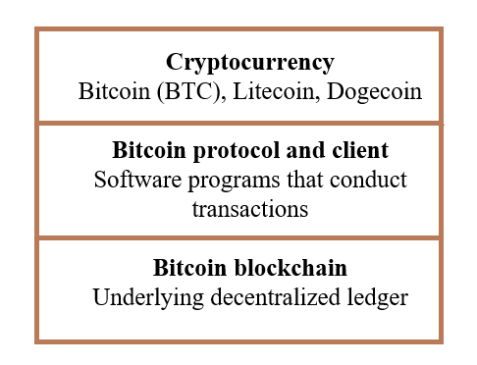
Fundamentals of Blockchain Technology
Layers in the technology stack of the Bitcoin blockchain

Slide 5
Fundamentals of Blockchain Technology
The first layer is the underlying technology, the blockchain — decentralized transparent ledger with the transaction records—the database that is shared by all network nodes, updated by miners, monitored by everyone, and owned and controlled by no one.
It is like a giant interactive spreadsheet that everyone has access to and updates and confirms that the digital transactions transferring funds are unique.
The middle tier of the stack is the protocol—the software system that transfers the money over the blockchain ledger.

Slide 6
Fundamentals of Blockchain Technology
Then, the top layer is the currency itself, Bitcoin, which is denoted as BTC or Btc when traded in transactions or exchanges.
There are hundreds of cryptocurrencies, of which Bitcoin is the first and largest.
Others include Litecoin, Dogecoin, Ripple, NXT, and Peercoin; the major alt-currencies can be tracked at http://coinmarketcap.com/.

Slide 7
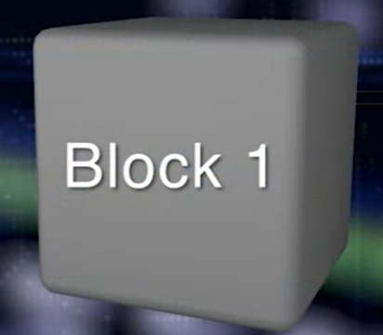
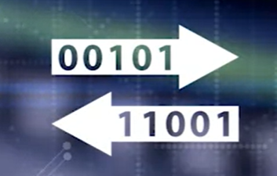

Fundamentals of Blockchain Technology
Transaction is the basic element of the Bitcoin Blockchain.
Transactions are validated and broadcasted.
Image Source: Coursera
Many transactions form a block.

Slide 8
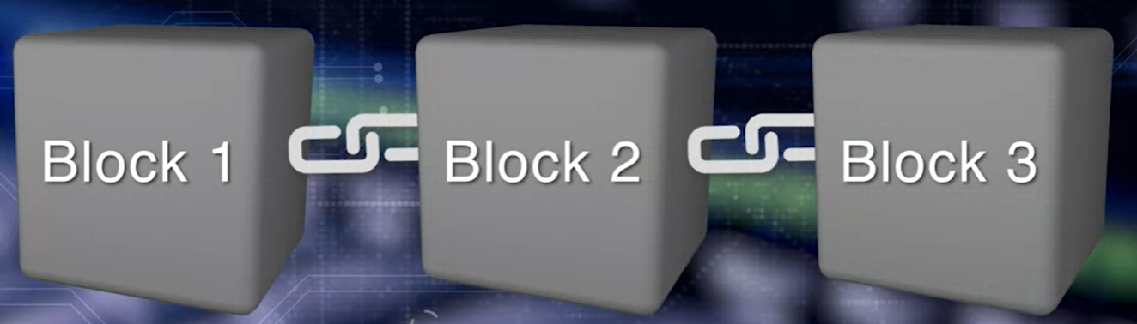
Fundamentals of Blockchain Technology
Many blocks form a chain through a digital data link.
Image Source: Coursera

Slide 9
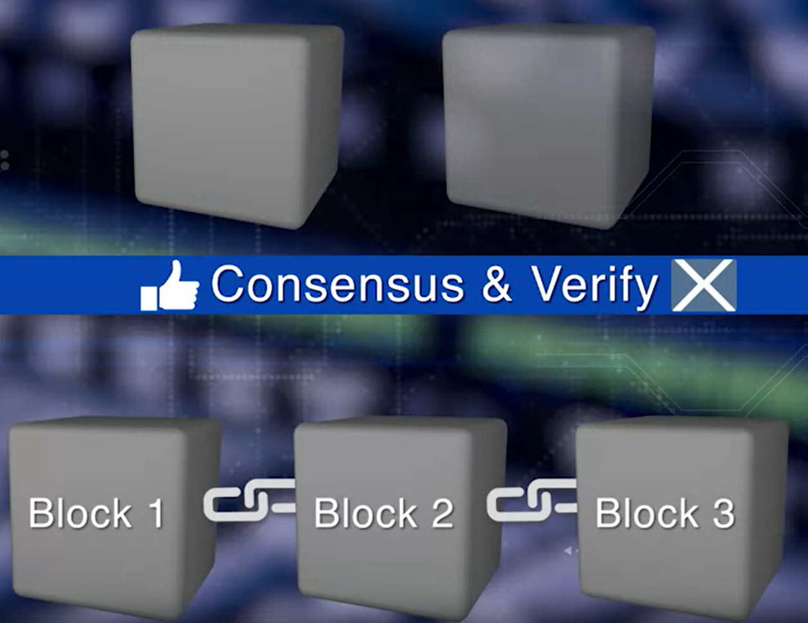
Fundamentals of Blockchain Technology

Slide 10
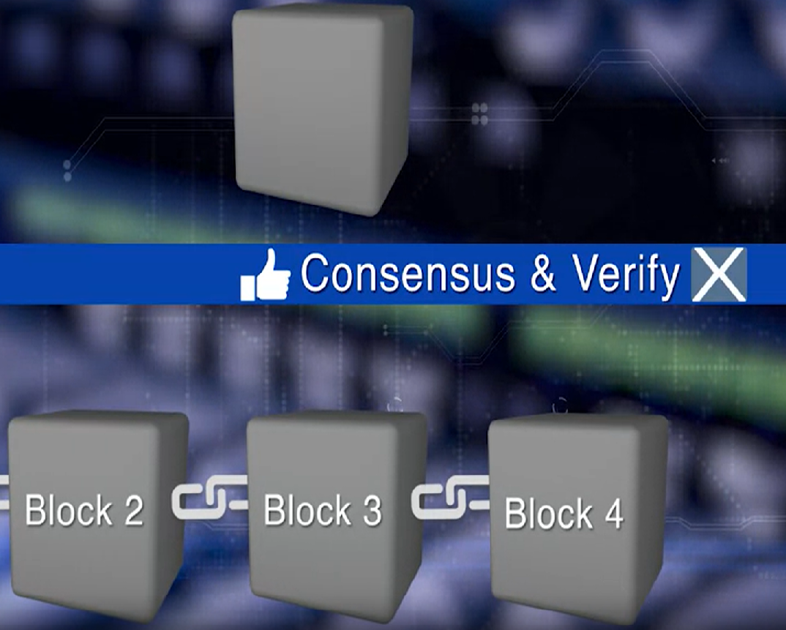
Fundamentals of Blockchain Technology
Image Source: Coursera

Slide 11
Fundamentals of Blockchain Technology
Blocks go through a consensus process, to select the next block that will be added to the chain. Chosen block is verified, and added to the current chain.
Validation and consensus process are carried out by special peer nodes called miners.
These are powerful computers executing software defined by the blockchain protocol.

