Slide 1
DIODE AND APPLICATIONS
Diode - Static and Dynamic resistances, Equivalent circuit, Diode Applications, Rectifier - Half Wave Rectifier, Full Wave Rectifier
Source: IARE

Slide 2
CONTENTS
Introduces the PN junction diodes.
Analysis of diode characteristics.
Equivalent circuits and load line.
Diodes in rectifiers.
2

Slide 3
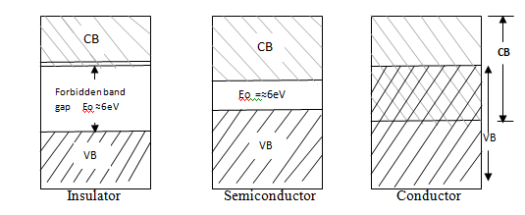
MATERIALS
Based on the electrical properties of the materials like conductivity, materials are divided into three types.
Conductors
Semiconductors
Insulators
Energy band diagrams for insulator, semiconductor and conductor
3

Slide 4

PN JUNCTION DIODE
What do you mean by diode?
A PN junction is a device formed by joining p-type with n-type semiconductors and separated by a thin junction is called PN Junction
4

Slide 5
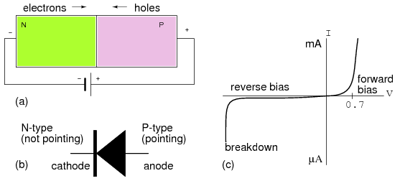
PN JUNCTION DIODE
5

Slide 6
THEORY OF PN JUNCTION DIODE
The depletion layer contains no free and mobile charge carriers but only fixed and immobile ions.
Its width depends upon the doping level.
Heavily doped……..thin depletion layer
lightly doped……..thick depletion layer
Forward bias mode: positive terminal connected to p-region and negative terminal connected to n region.
Reverse bias mode: negative terminal connected to p- region and positive terminal connected to n region
6

Slide 7
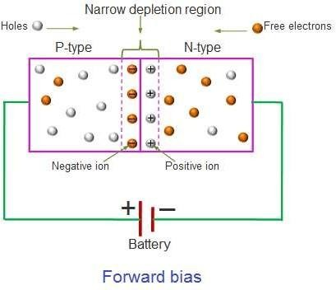
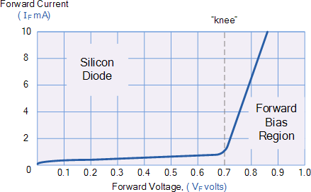
PN JUNCTION – FORWARD BIAS
It forces the majority of charge carriers to move across the junction decreasing the width of the depletion layer.
7

Slide 8
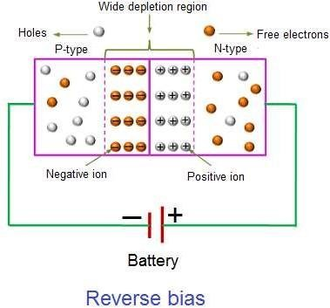
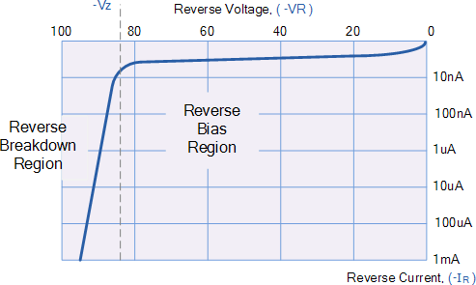
PN JUNCTION – REVERSE BIAS
The free electrons and free holes are attracted towards the battery, hence depletion layer width increases.
8

Slide 9
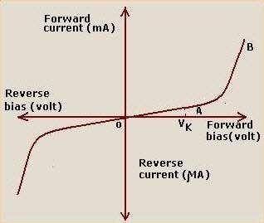
V-I CHARACTERISTICS OF PN JUNCTION DIODE
V-I characteristics of PN junction diode
9

Slide 10
STATIC OR DC RESISTANCE
The resistance of a diode at a particular operating point is called the dc or static resistance diode.
The resistance of the diode at the operating point can be found
simply by finding the corresponding levels of V_{D} and I_{D.}
It can be determined using the equation
R_{D} =V_{D}/I_{D}
The lower current through a diode the higher the dc resistance level
10

Slide 11
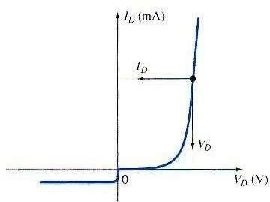
STATIC OR DC RESISTANCE
Fig: Static resistance curve
11

Slide 12
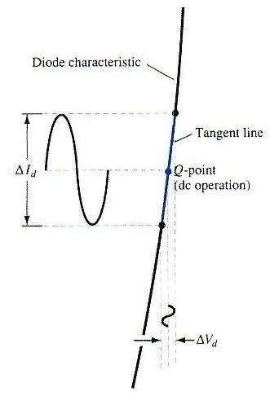
DYNAMIC OR AC RESISTANCE
Static resistance is using dc input. If the input is sinusoidal the scenario will change.
The ac resistance is determined by straight line drawn between the two intersections of the
Maximum and minimum values of input voltage.
Fig: Dynamic resistance curve
12

Slide 13
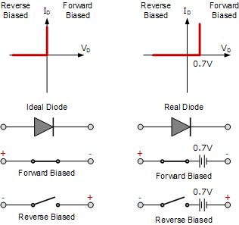
PN JUNCTION DIODE CHARACTERISTICS
13

Slide 14
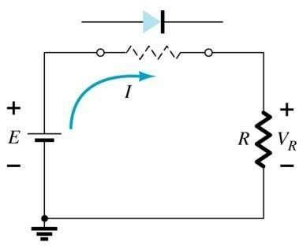
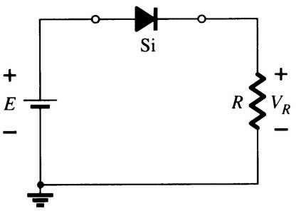
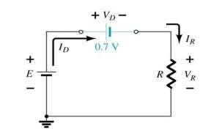
DIODE EQUIVALENT CIRCUIT
When a diode is F.B, we can use the model for approximate the on state
14

Slide 15
DIODE APPLICATIONS
common applications of diodes are
Switches
Rectifiers
Clipper Circuits
Clamping Circuits
Reverse Current Protection Circuits
In Logic Gates
Voltage Multipliers
15

Slide 16
RECTIFIER
A circuit that converts ac voltage of main supply into pulsating dc voltage using one or more PN junction diodes is called rectifier.
Half Wave Rectifier
Full Wave Rectifier
Bridge Rectifier
16

Slide 17
Half Wave Rectifier
The process of removing one-half the input signal to establish a dc level is called half-wave rectification.
In Half wave rectification, the rectifier conducts current during positive half cycle of input ac signal only.
Negative half cycle is suppressed.
17

Slide 18
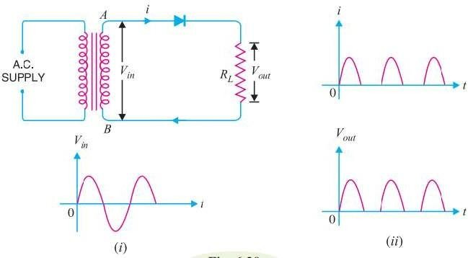
Half Wave Rectifier
18

Slide 19

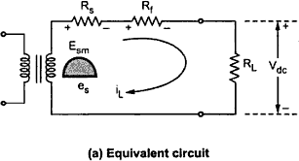



HALF WAVE RECTIFIER
Average DC load Current (I_{DC}):
19

Slide 20


HALF WAVE RECTIFIER
Average DC voltage (Edc):
20

Slide 21


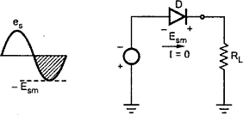
HALF WAVE RECTIFIER
RMS Load Current (Irms):
➔
RMS Load Voltage (Erms):
Peak Inverse Voltage (PIV):
PIV = Em
Diode must be selected based on the PIV rating and the circuit specification.
21

Slide 22


HALF WAVE RECTIFIER
DC Power Delivered to the load:
22

Slide 23
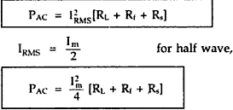
HALF WAVE RECTIFIER
AC input power from transformersecondary:
23

Slide 24


HALF WAVE RECTIFIER
Rectifier Efficiency(η):
; η= 40.6 %
Under best conditions (no diode loss) only 40.6% of the ac input power is
converted into dc power.
The rest remains as the ac power in the load
24

Slide 25





HALF WAVE RECTIFIER
Ripple Factor:
(or)
➔
This indicates that the ripple content in the output are 1.211 times the dc
component.
i.e. 121.1 % of dc component.
25

Slide 26
HALF WAVE RECTIFIER
Disadvantage of HWR:
The ripple factor of half wave rectifier is 1.21, which is quite high.
The output contains lot of ripples
The maximum theoretical efficiency is 40%.
The practical value will be quite less than this.
This indicates that HWR is quite inefficient.
26

Slide 27
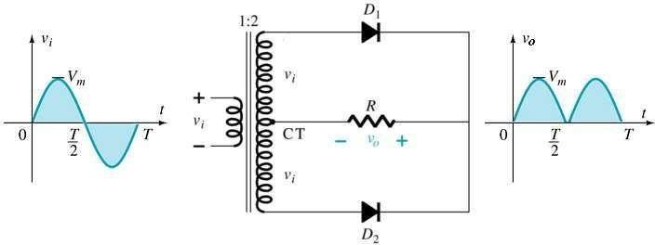
FULL WAVE RECTIFIER
A
C
B
The full wave rectifier circuit consists of two power diodes connected to a single load resistance (R_{L}) with each diode taking it in turn to supply current to the load.
When point A of the transformer is positive with respect to point C, diode D₁ conducts in the forward direction as indicated by the arrows.
27

Slide 28
FULL WAVE RECTIFIER
When point B is positive (in the negative half of the cycle) with respect to point C, diode D₂ conducts in the forward direction and the current flowing through resistor R is in the same direction for both half-cycles.
As the output voltage across the resistor R is the phasor sum of the two waveforms combined, this type of full wave rectifier circuit is also known as a “bi-phase” circuit.
28

Slide 29
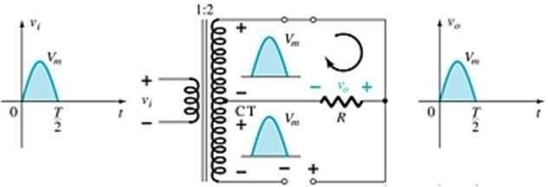
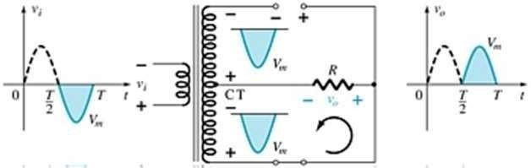
FULL WAVE RECTIFIER
Current Flow during the positive half of the input cycle
Current Flow during the negative half of the input cycle
29

Slide 30




FULL WAVE RECTIFIER
Average DC current:
Average (DC): Voltage
30

Slide 31




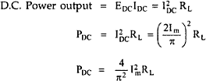
FULL WAVE RECTIFIER
RMS Load Current (Irms):
➔
➔
RMS Load Voltage:
DC Output Power:
31

Slide 32
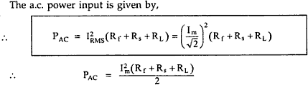



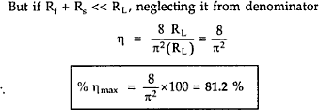
FULL WAVE RECTIFIER
AC input power (Pac):
Rectifier Efficiency(η):
=>
=>
32

Slide 33



FULL WAVE RECTIFIER
Ripple Factor:
33

Slide 34
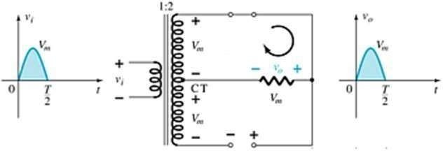
FULL WAVE RECTIFIER
Peak Inverse Voltage:
34

Slide 35
FULL WAVE RECTIFIER
Advantages of Full Wave Rectifier:
Efficiency is higher.
The large dc power output
The ripple factor is less
Disadvantages of Full Wave Rectifier:
PIV rating of diode is higher.
Higher PIV diodes are larger in size and costlier.
The cost of center tap transformer is high.
35

