Slide 1
BIPOLAR JUNCTION TRANSISTOR
Principle of Operation and characteristics - Common Emitter, Common Base, Common Collector Configurations, Operating point, DC & AC load lines, Transistor Hybrid parameter model
Source: IARE
1

Slide 2
CONTENTS
Introduction
Common Emitter Configuration
Common Base Configuration
Common Collector Configuration
Operating point, DC & AC load lines
Transistor Hybrid parameter model
2

Slide 3

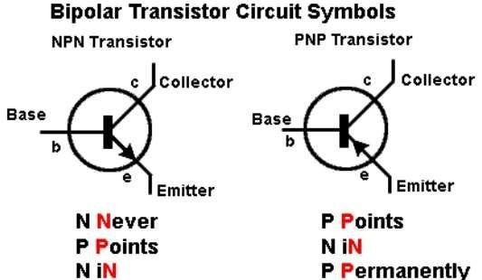
INTRODUCTION
Introduction
Transistor is a device that can be used as either an amplifier or a switch. Transistor is current controlling device.
3

Slide 4
INTRODUCTION
Introduction
The three layers of BJT are called Emitter, Base and Collector
Base is very thin compared to the other two layers
Base is lightly doped. Emitter is heavily doped. Collector is moderately
doped
NPN – Emitter and Collector are made of N-type semiconductors; Base is P-type
PNP – Emitter and Collector are P-type, Base is N-type
Both types (NPN and PNP) are extensively used, either separately or in the same circuit
BJT has two junctions – Emitter-Base (EB) Junction and Collector-Base (CB) Junction
The device is called “bipolar junction transistor” because current is due
to motion of two types of charge carriers – free electrons & holes
Transistor Analogous to two diodes connected back-to-back: EB diode and CB diode
4

Slide 5
TRANSISTOR OPERATION
TRANSISTOR OPERATION
Operation of NPN transistor is discussed here
For normal operation (amplifier application)
– EB junction should be forward biased
– CB junction should be reverse biased
Depletion width at EB junction is narrow (forward biased)
Depletion width at CB junction is wide (reverse biased)
When EB junction is forward biased, free electrons from emitter region drift towards base region
Some free electrons combine with holes in the base to form small
base current
5

Slide 6
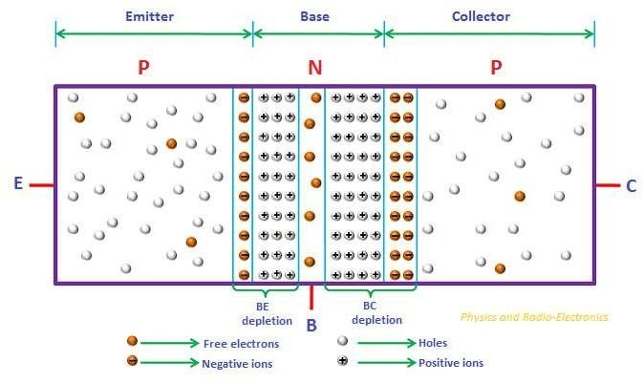
TRANSISTOR OPERATION
Transistor Operation
6

Slide 7
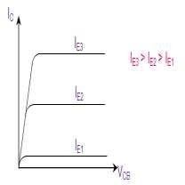
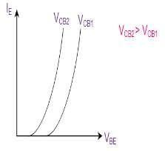
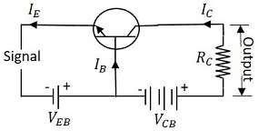
TRANSISTOR CHARACTERISTICS
TRANSISTOR CHARACTERISTICS
Common Base (CB) Configuration of Transistor
In CB Configuration, the base terminal of the transistor will be common between
the input and the output terminals as shown by Fig.4. This configuration offers low input impedance, high output impedance, high resistance gain and high
voltage gain.
Fig.4: NPN Transistor in CB Configuration
Fig.5: CB Configuration I/P Characteristics
Fig.6: CB Configuration O/P Characteristics
7

Slide 8
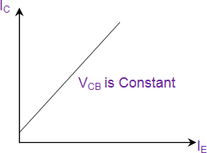



TRANSISTOR CHARACTERISTICS
TRANSISTOR CHARACTERISTICS
This leads to the expression for the input resistance as
output resistance can be obtained as
The current gain has a value less than 1 and can expressed as
Fig.7: CB Configuration Current
Transfer Characteristics
Common Collector (CC) Configuration of Transistor
8

Slide 9
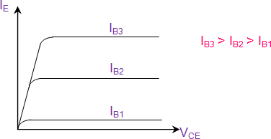
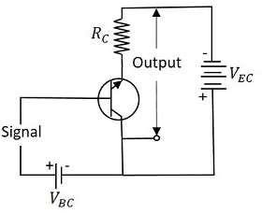
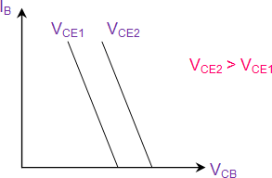
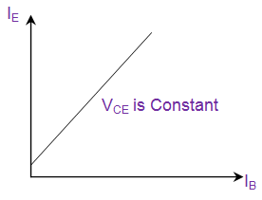
TRANSISTOR CHARACTERISTICS
TRANSISTOR CHARACTERISTICS
This offers high input impedance, low output impedance, voltage gain less than
one and a large current gain.
Fig.10: CC Configuration O/P Characteristics
Fig.9: CC Configuration I/P Characteristics
Fig.8: NPN Transistor in CC
Configuration
Fig.11: CC Configuration Current
Transfer Characteristics
9

Slide 10
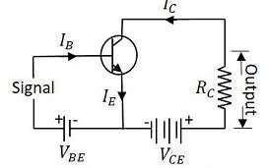
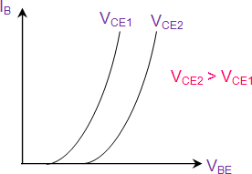
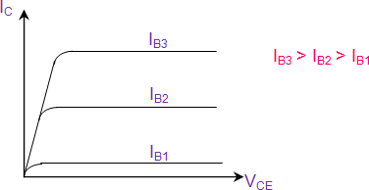
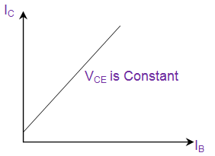
TRANSISTOR CHARACTERISTICS
TRANSISTOR CHARACTERISTICS
Common Emitter (CE) Configuration of Transistor
In this configuration, the emitter terminal is common between the input and
t he output terminals as shown by Fig.12. This configuration offers medium
input impedance, medium output impedance, medium current gain and
voltage gain.
Fig.12 NPN Transistor in CE Configuration
Fig.13: CE Configuration I/P
Characteristics
Fig.14: CE Configuration O/P
Characteristics
Fig.15: CE Configuration Current Transfer Characteristics
10

Slide 11
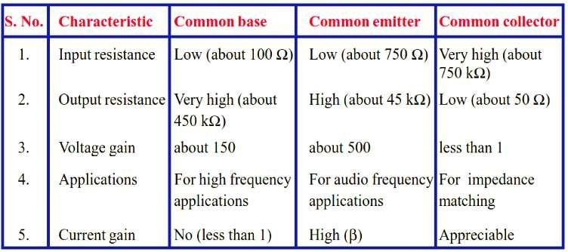
COMPARISON OF TRANSISTOR CONFIGURATIONS
11

Slide 12
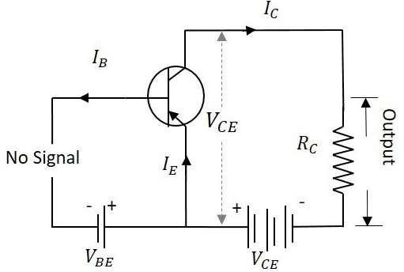
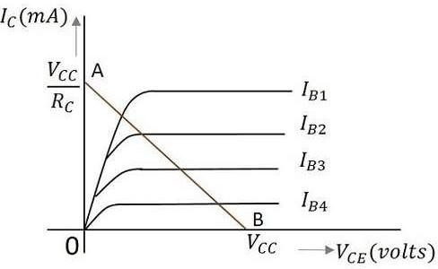
DC AND AC LOAD LINE
DC and AC Load Line
DC Load Line
Fig.17: CE Amplifier circuit with no I/P
signal
Fig.18: CE O/P characteristics with DC
load line
The value of collector emitter voltage at any given time will be
V_{CE}=V_{CC}−I_{C}R_{C}
The fig.18 shows the DC load line.
To obtain the load line, two points be A and B of the straight line are to be
determined.
12

Slide 13
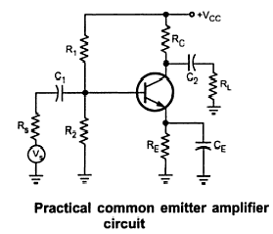
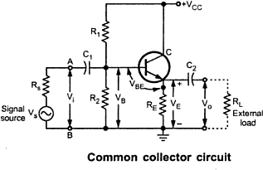
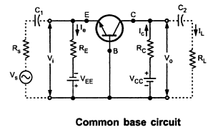
TRANSISTOR HYBRID PARAMETER MODEL
TRANSISTOR HYBRID PARAMETER MODEL
CE, CC, & CB Amplifiers
13

Slide 14
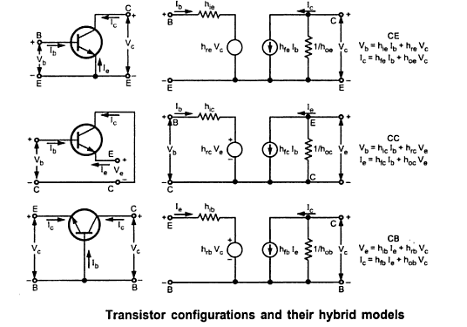
TRANSISTOR HYBRID PARAMETER MODEL
TRANSISTOR HYBRID PARAMETER MODEL
Hybrid model of CE, CC, & CBAmplifiers
14

Slide 15
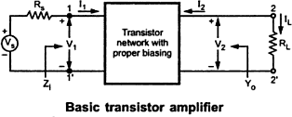
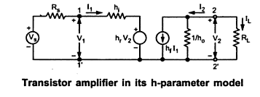
TRANSISTOR HYBRID PARAMETER MODEL
TRANSISTOR HYBRID PARAMETER MODEL
Small Signal Analysis Of A JunctionTransistor
15

Slide 16
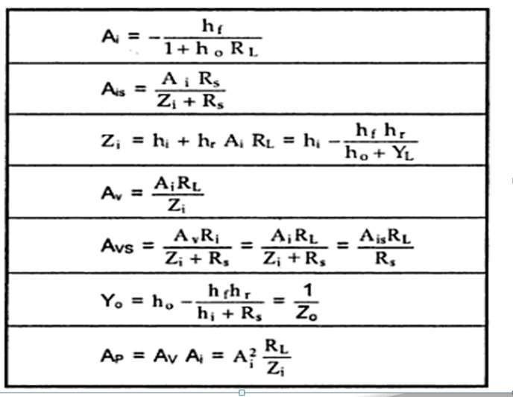
TRANSISTOR HYBRID PARAMETER MODEL
TRANSISTOR HYBRID PARAMETER MODEL
Small signal analysis of transistoramplifier
16

Slide 17
TRANSISTOR HYBRID PARAMETER MODEL
TRANSISTOR HYBRID PARAMETER MODEL
Steps for ac analysis of a transistor circuit
Draw the actual circuit diagram
Replace Coupling Capacitors & emitter bypass capacitor by short circuit
Replace dc source by a short circuit. In other words, short v_{cc} and ground lines
Mark the points B(base), C(collector), E(emitter) on the circuit diagram and
locate these points as the start of the equivalent circuit.
Replace the transistor by its h-parameter model.
17

